Slide 1
Introduction to Bioinformatics
In the name of the most high
DNA
Ali Sharifi-Zarchi
Department of Computer Engineering, Sharif University of Technology
The contents including images and videos are from Bruce Alberts et al. Essential Cell Biology,
unless indicated separately.
These slides are available under the Creative Commons Attribution License.

Slide 2
DNA
The Language of Life

Slide 3
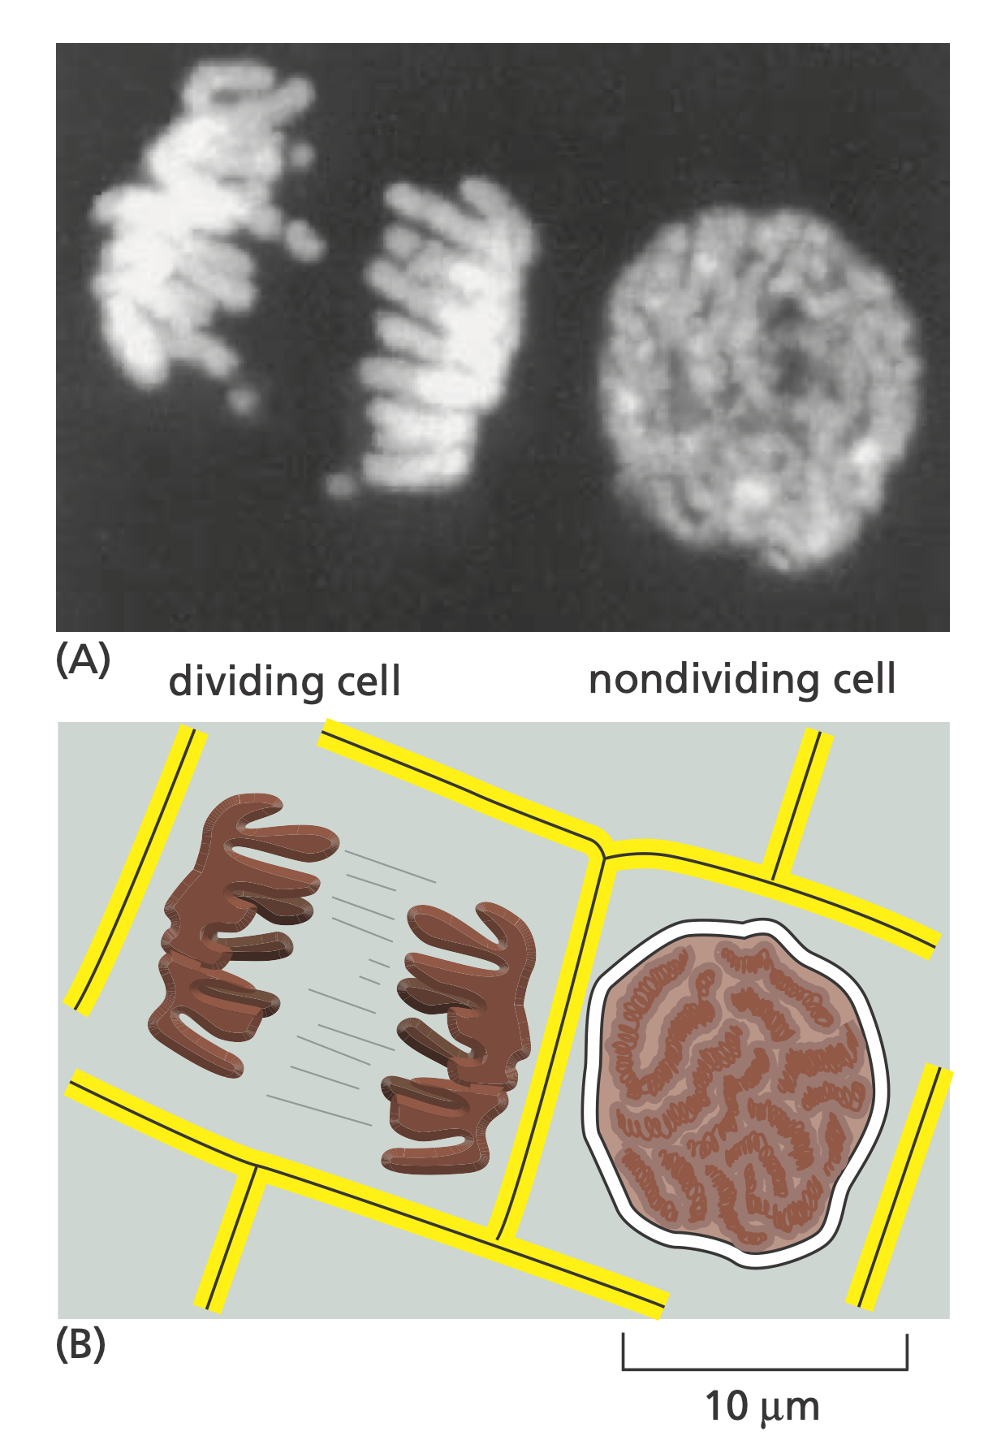
Nucleus

Slide 4
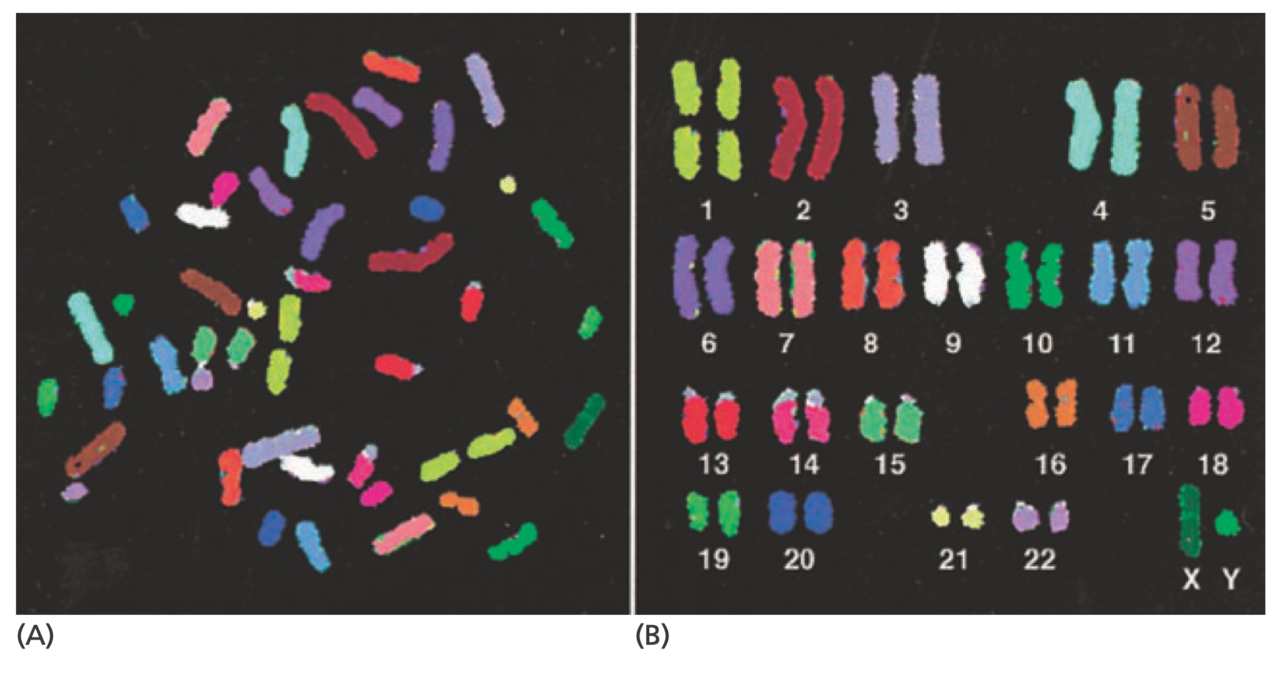
Chromosomes

Slide 5
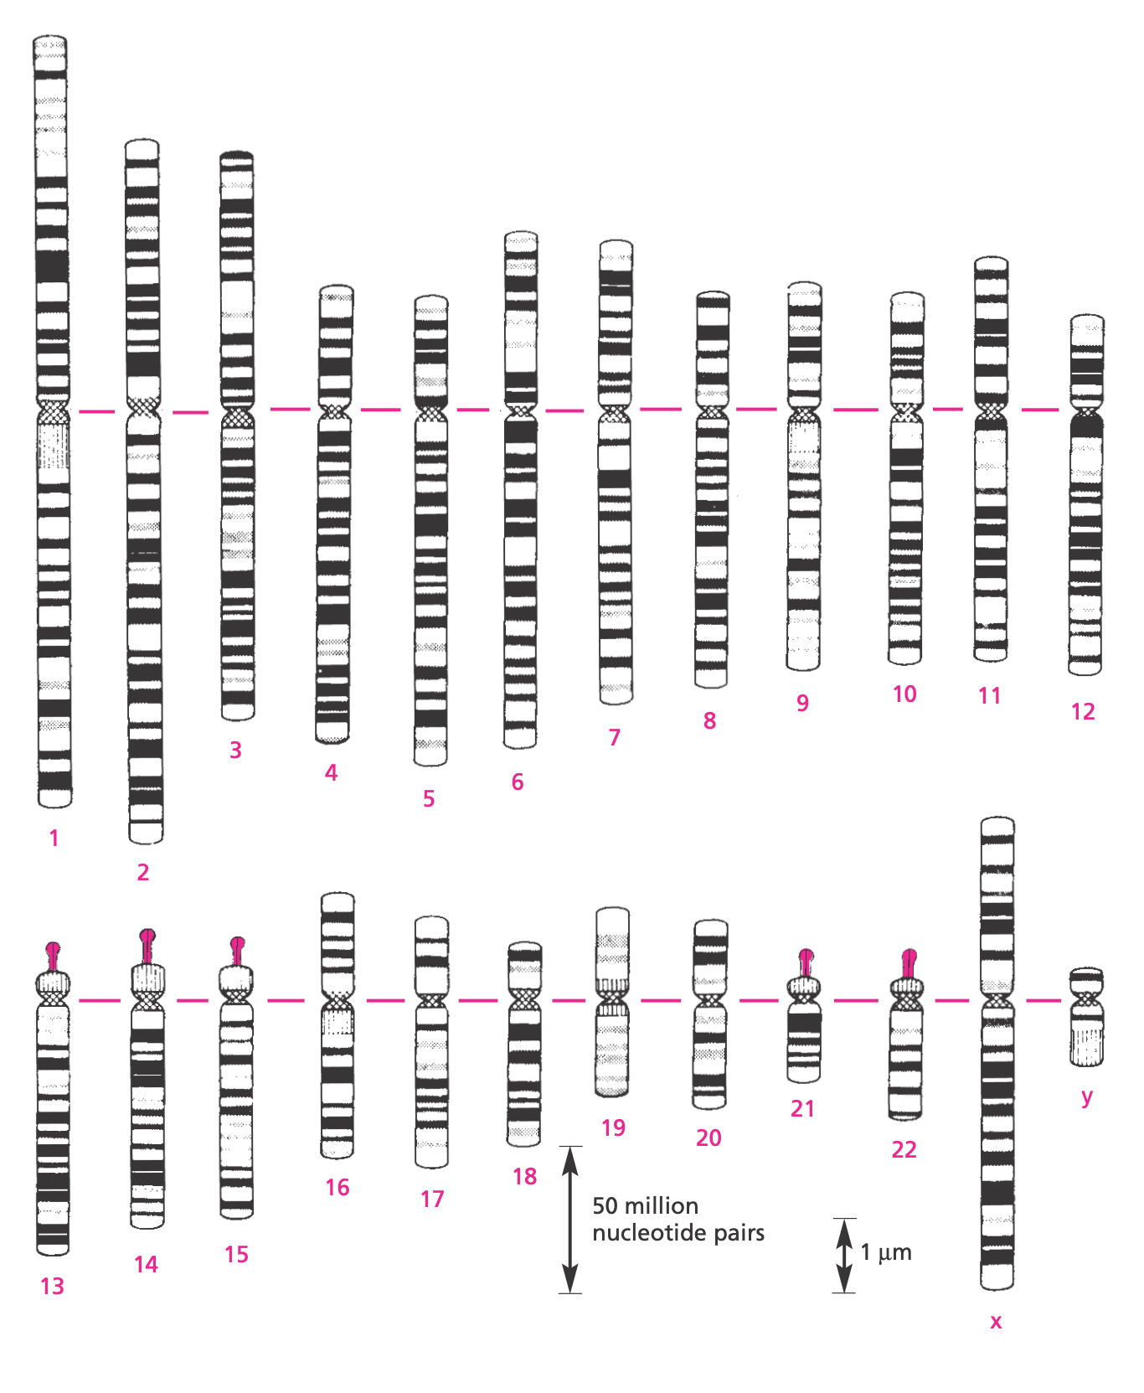
Chromosomes

Slide 6
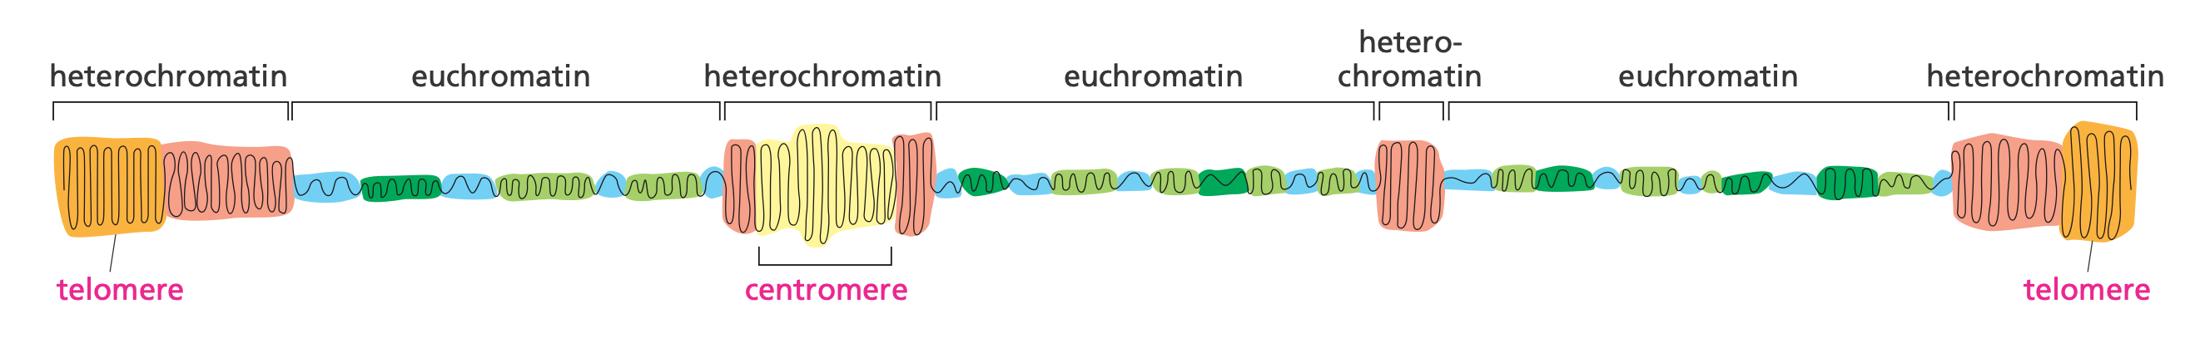
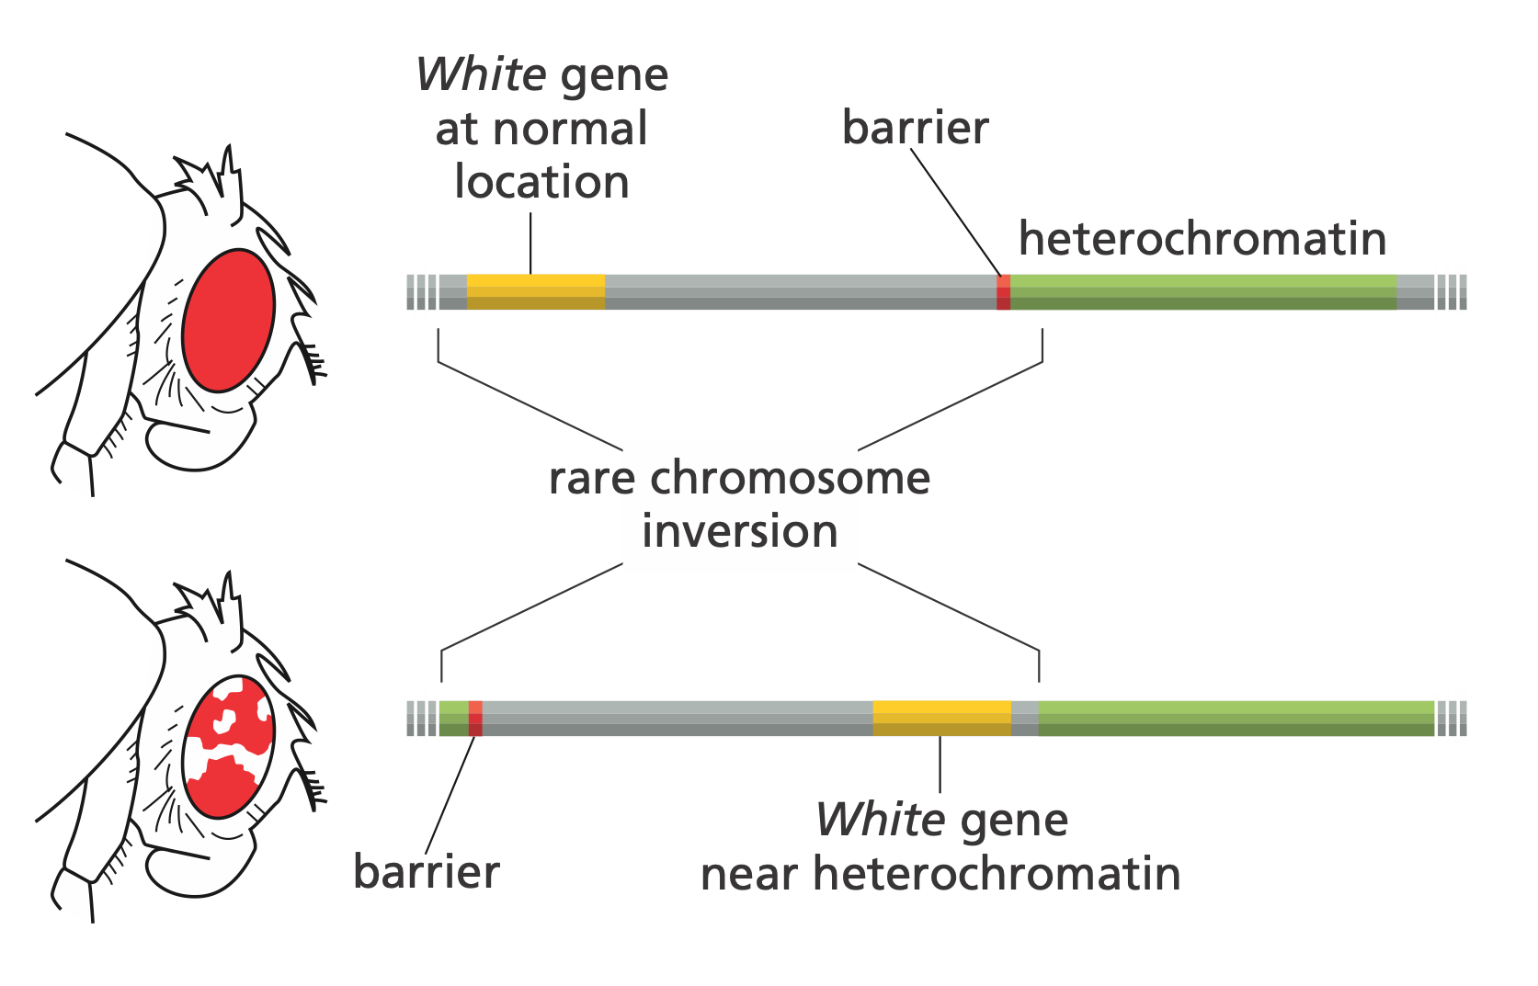
Heterochromatin and Euchromatin
Notes:
Wild-type flies with a normal White gene (White+) have normal pigment production, which gives them red eyes, but if the White gene is mutated and inactivated, the mutant flies (White–) make no pigment and have white eyes.

Slide 7
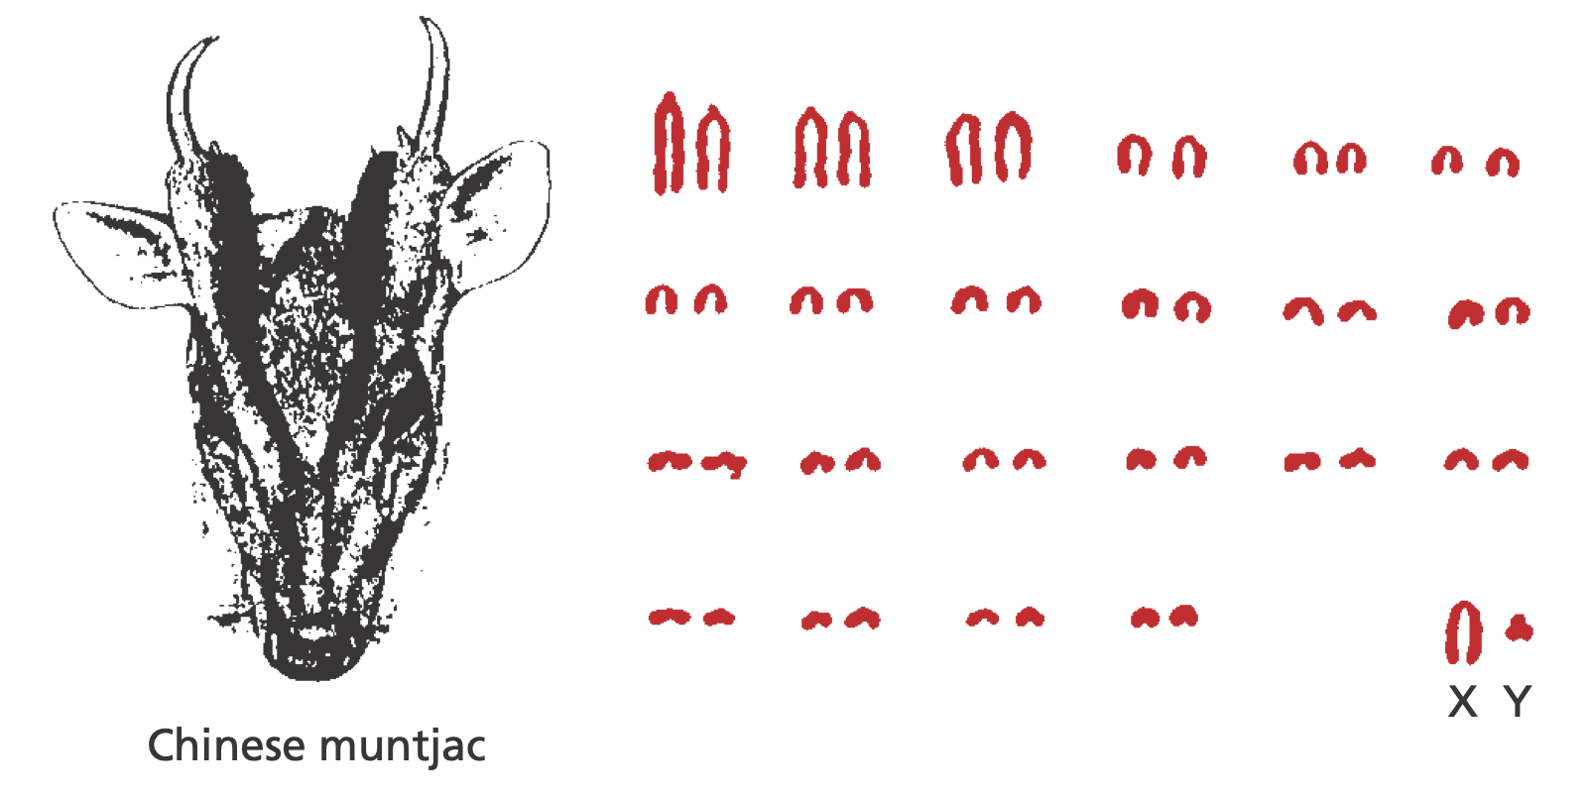
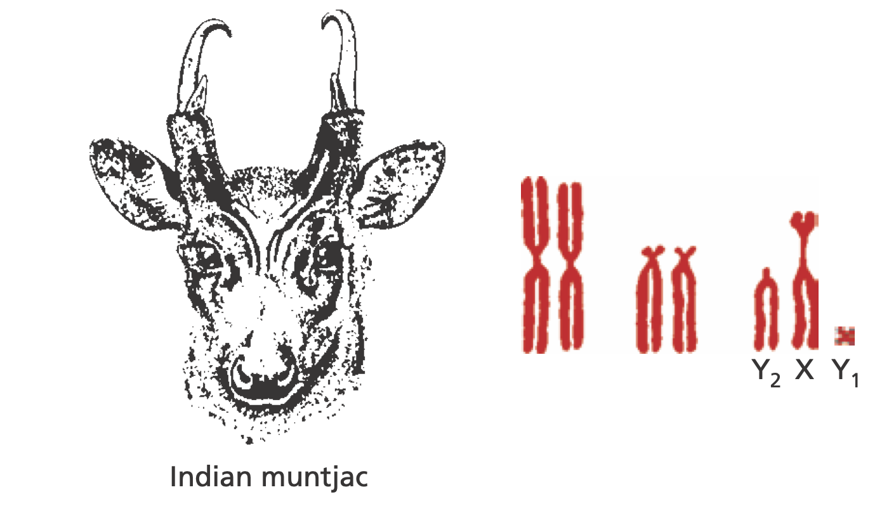
Close Animals can have different Chromosome Numbers

Slide 8
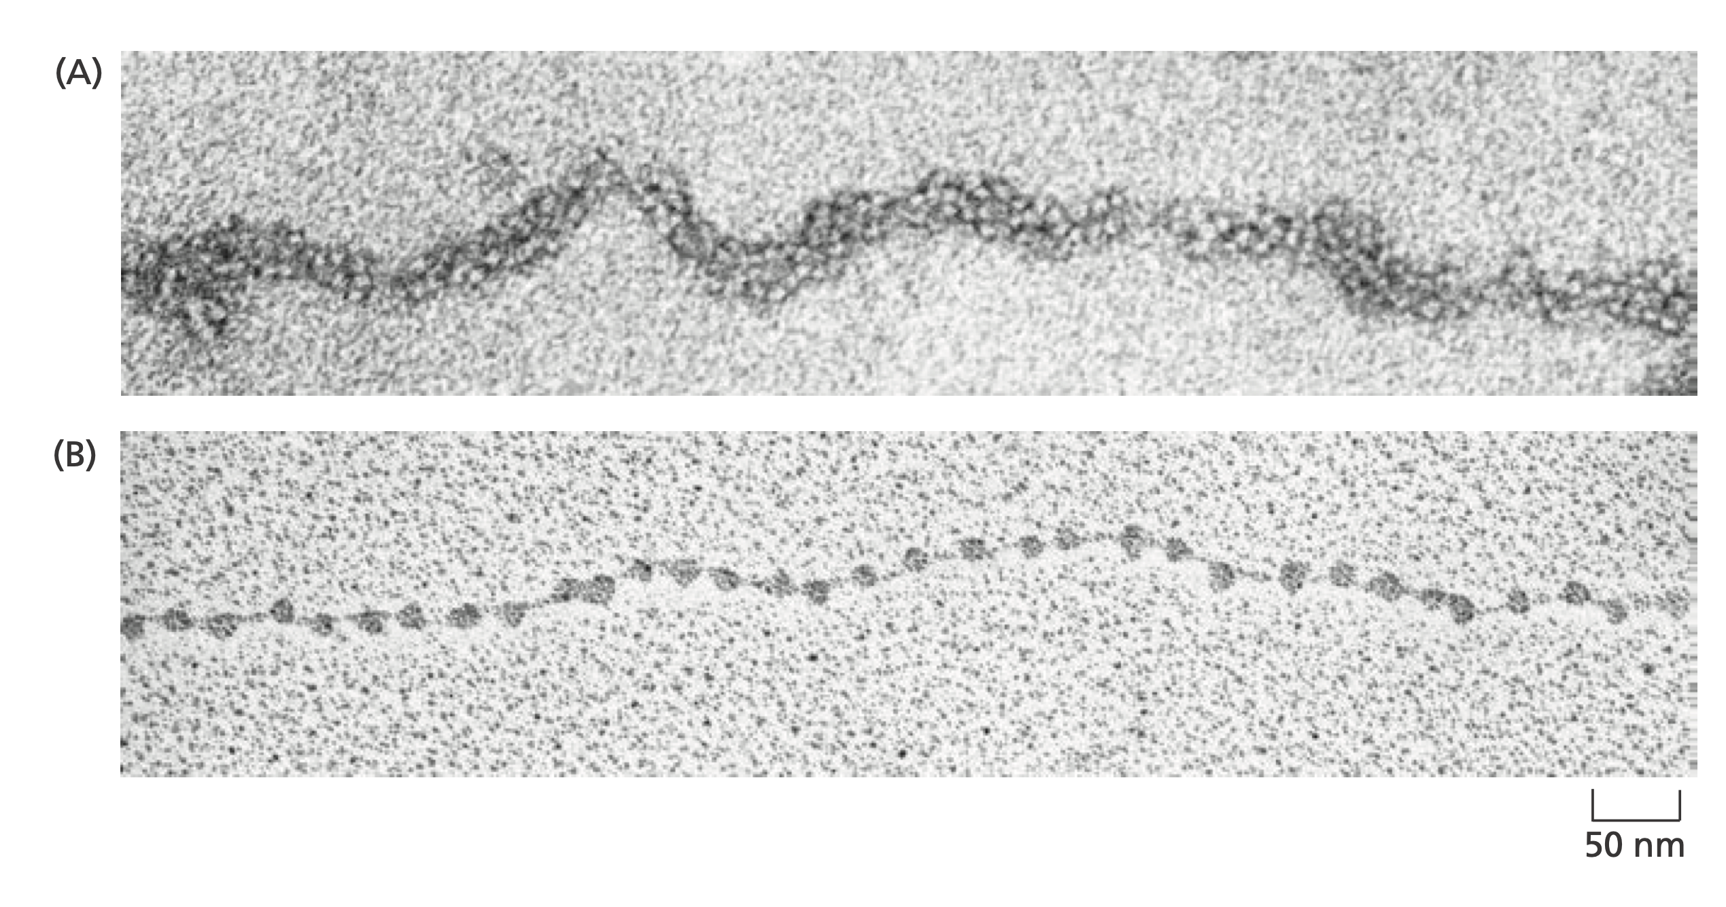
Nucleosomes

Slide 9
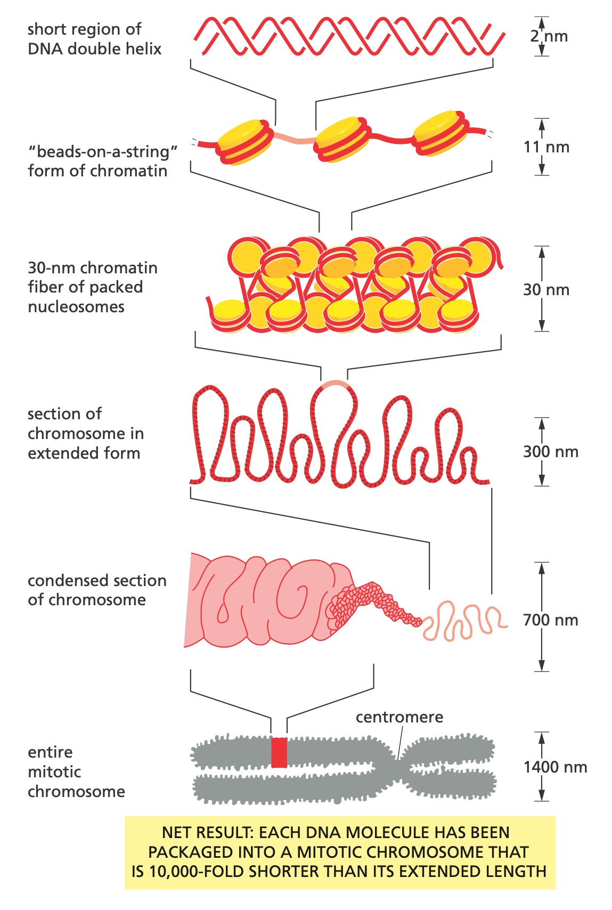
Super-helix Structure of Chromosomes

Slide 10
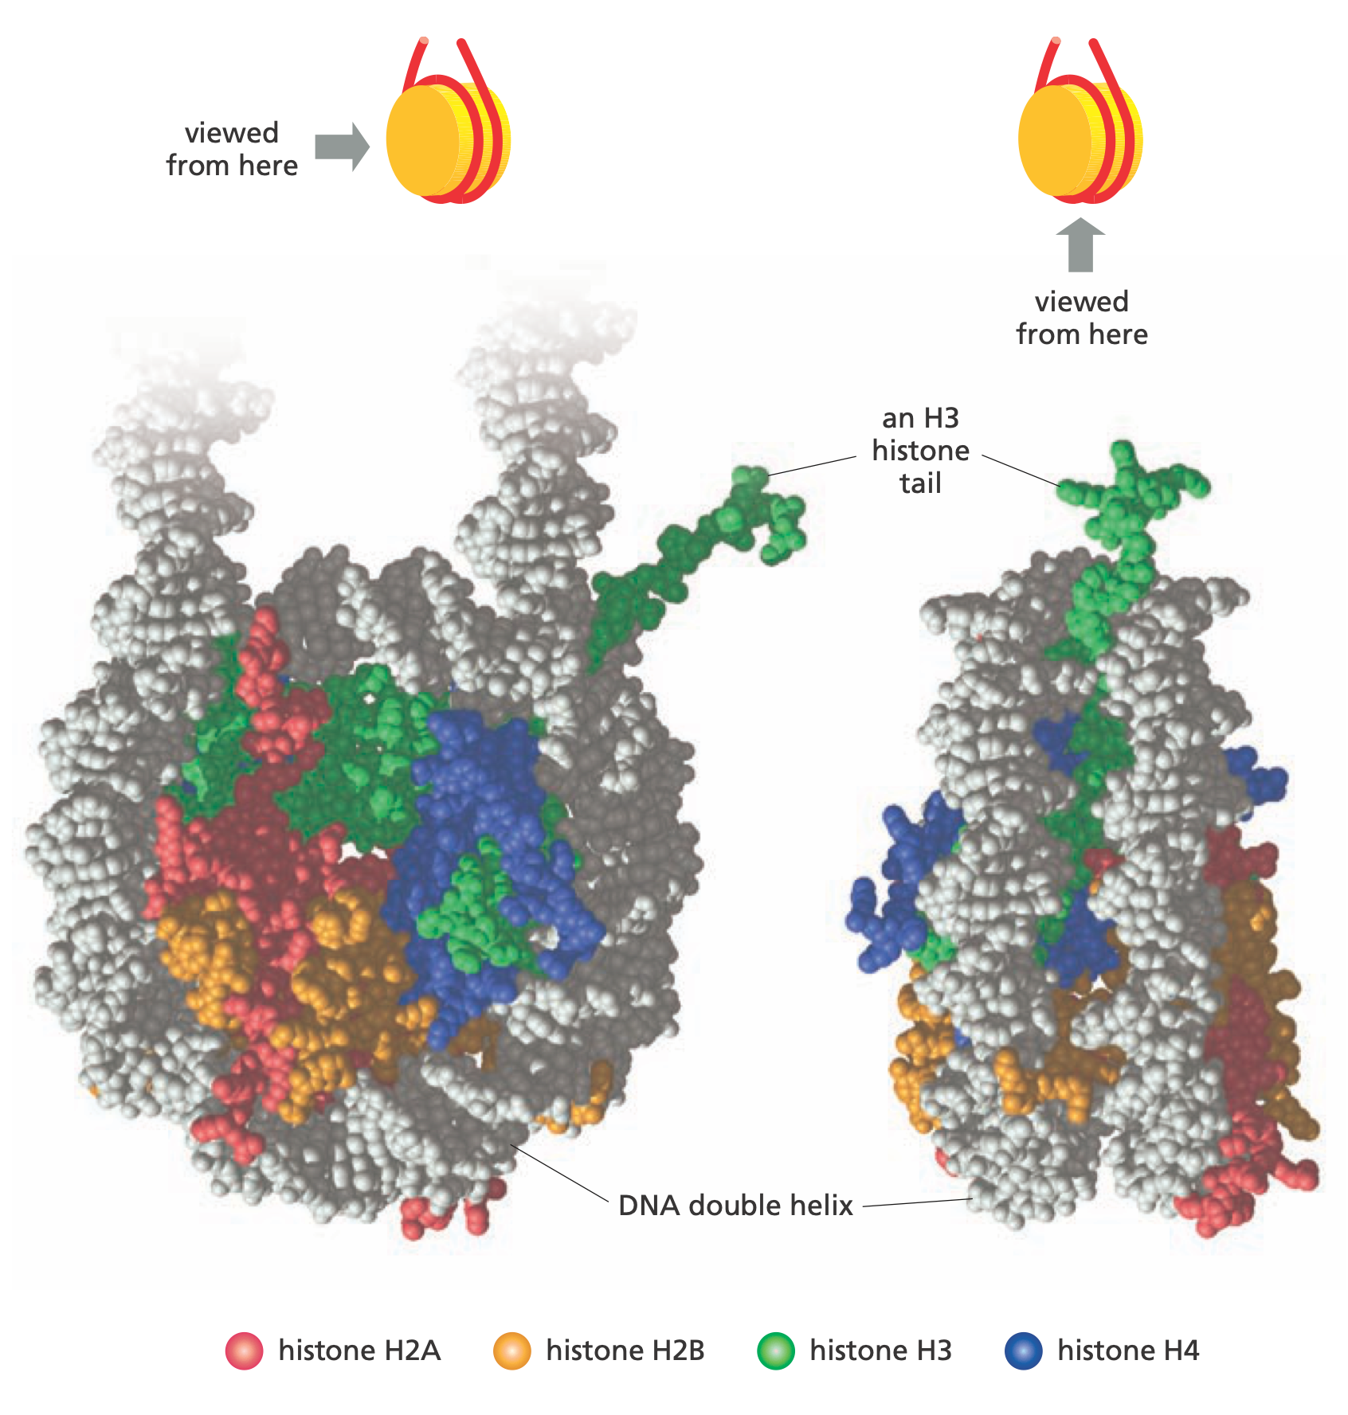
Histone Proteins

Slide 11
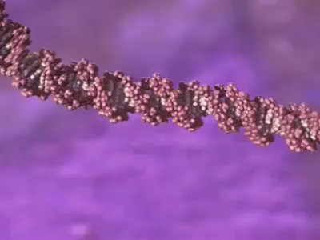
Chromosome Coiling

Slide 12
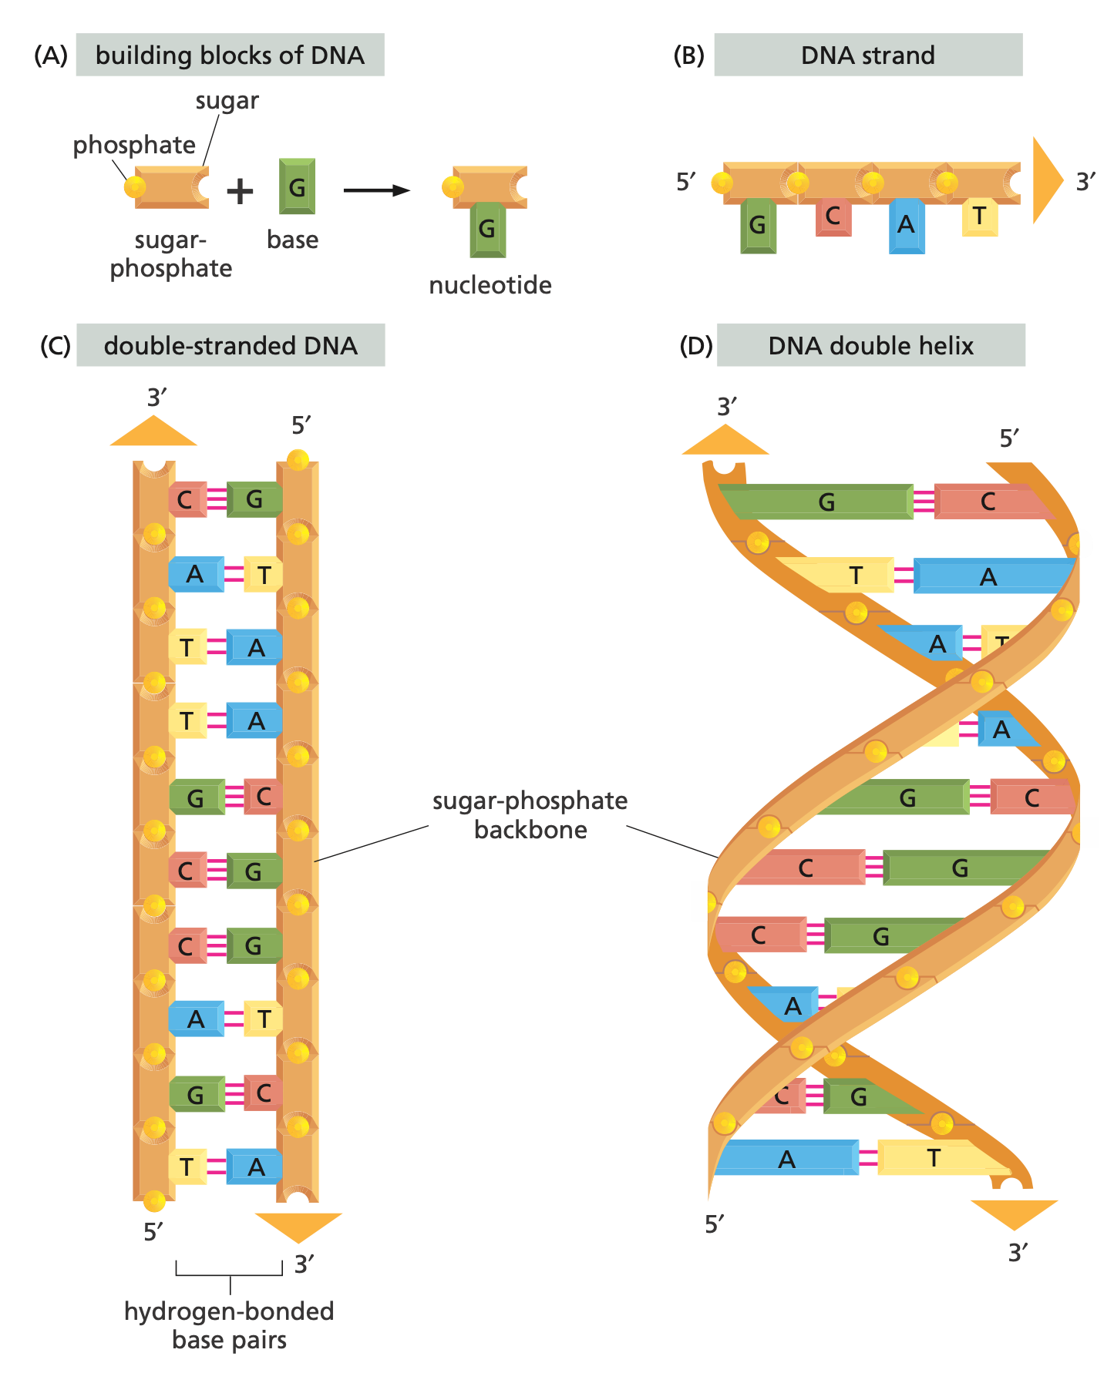
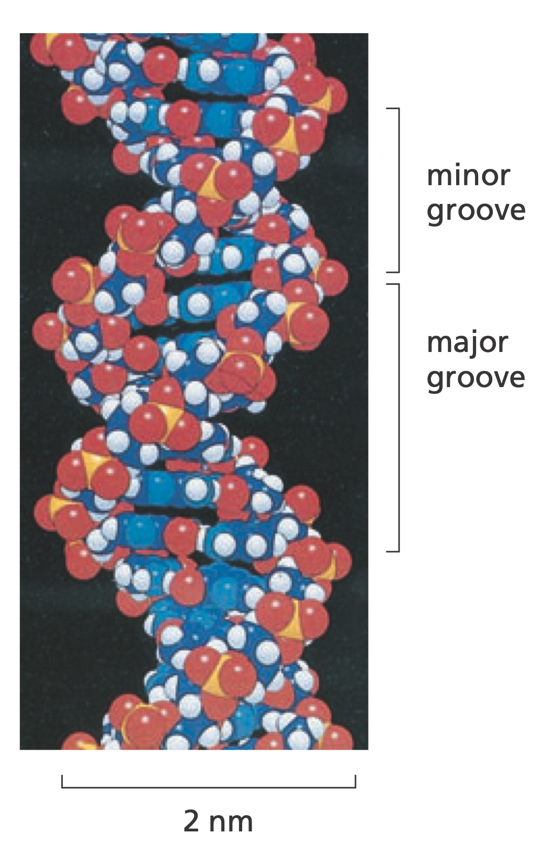
DNA

Slide 13
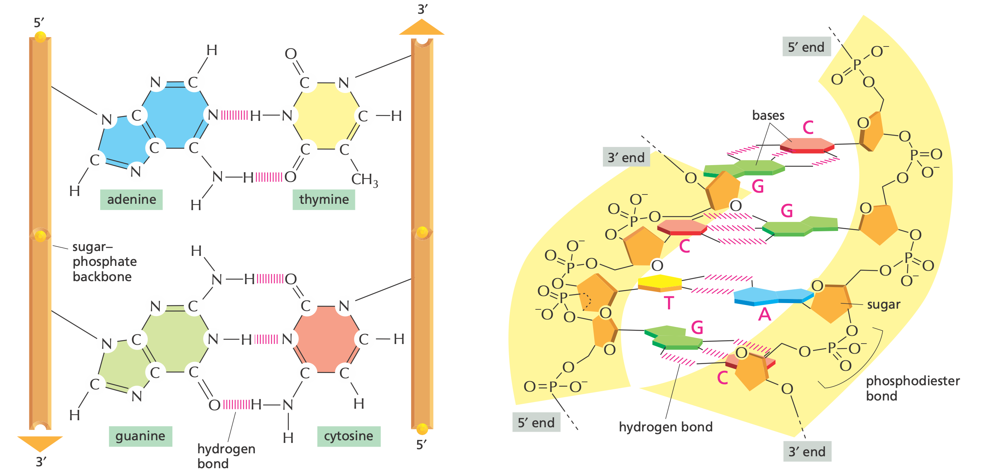
DNA Structure

Slide 14
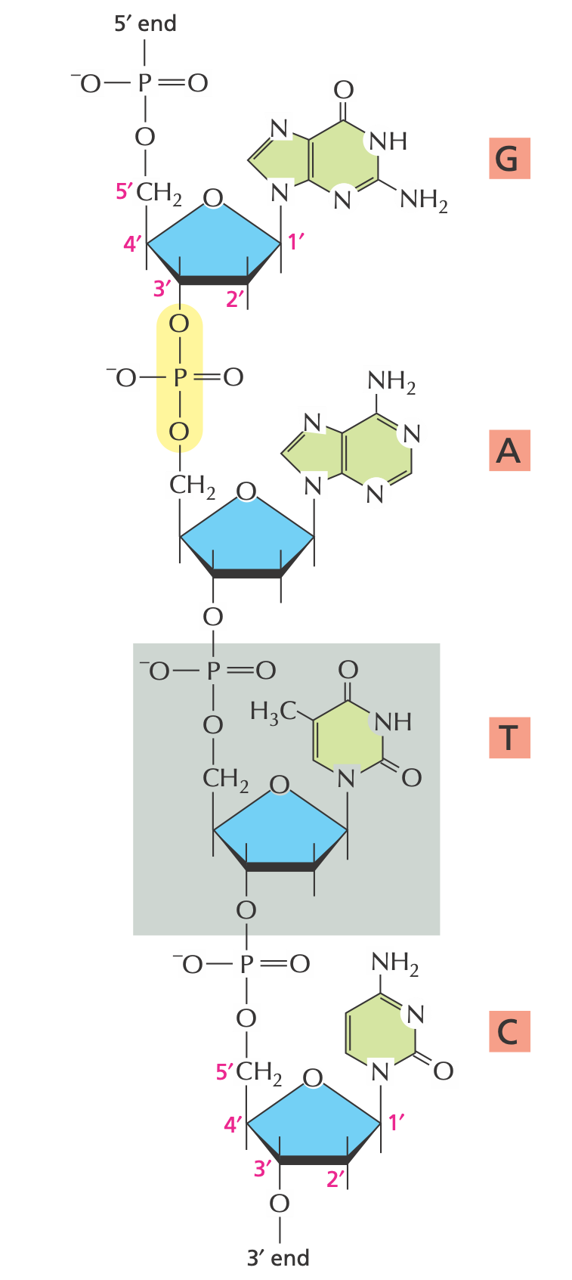
5’, 3’

Slide 15
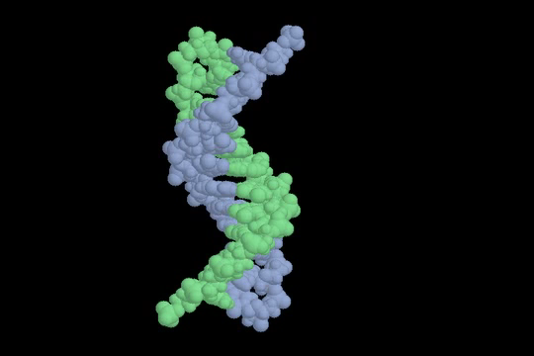
DNA Structure

Slide 16
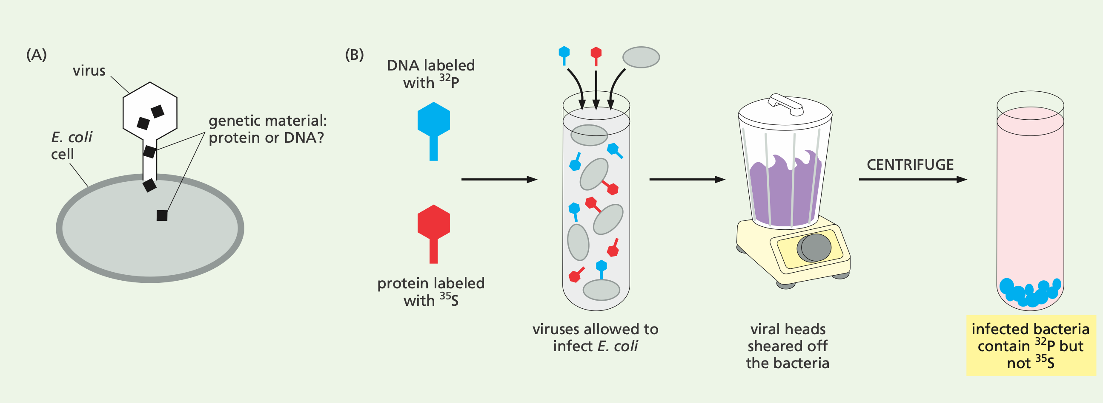
What is the genetic material?
Notes:
In 1952, Hershey and Chase ended a debate on whether Protein or DNA is the genetic material. The T2 phages contain only DNA and protein. They prepared one bath of virus with radioactive labelled DNA, one with labelled protein. They infected E-coli with the mixture of T2, blended to remove the empty caps of the virus outside bacteria, and centrifuged the mixture to separate bacteria. It contained only labelled DNA

Slide 17
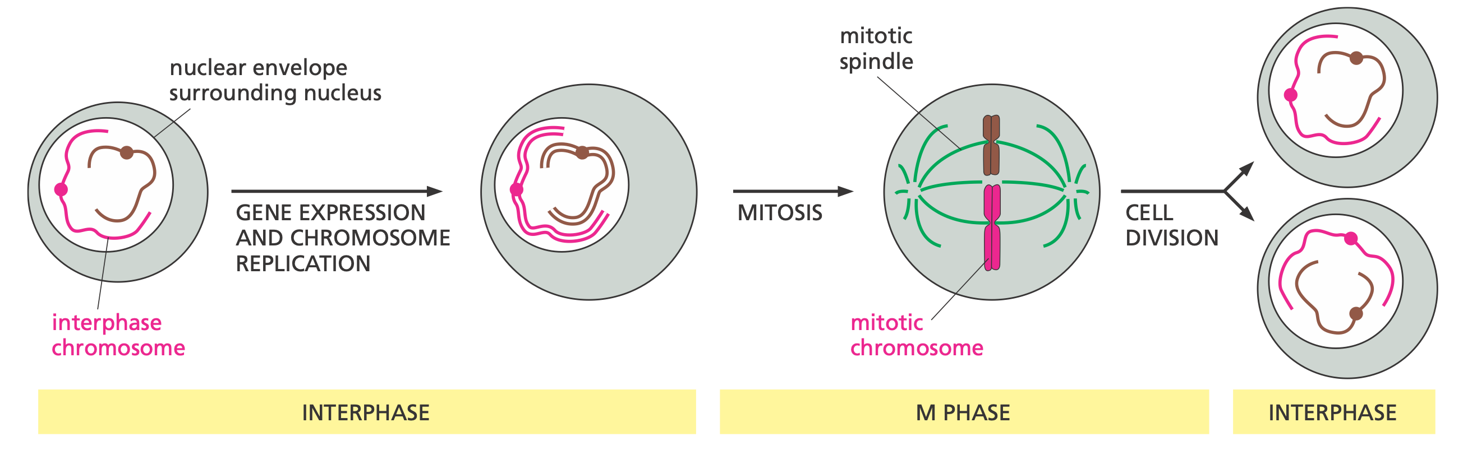
Cell Division

Slide 18
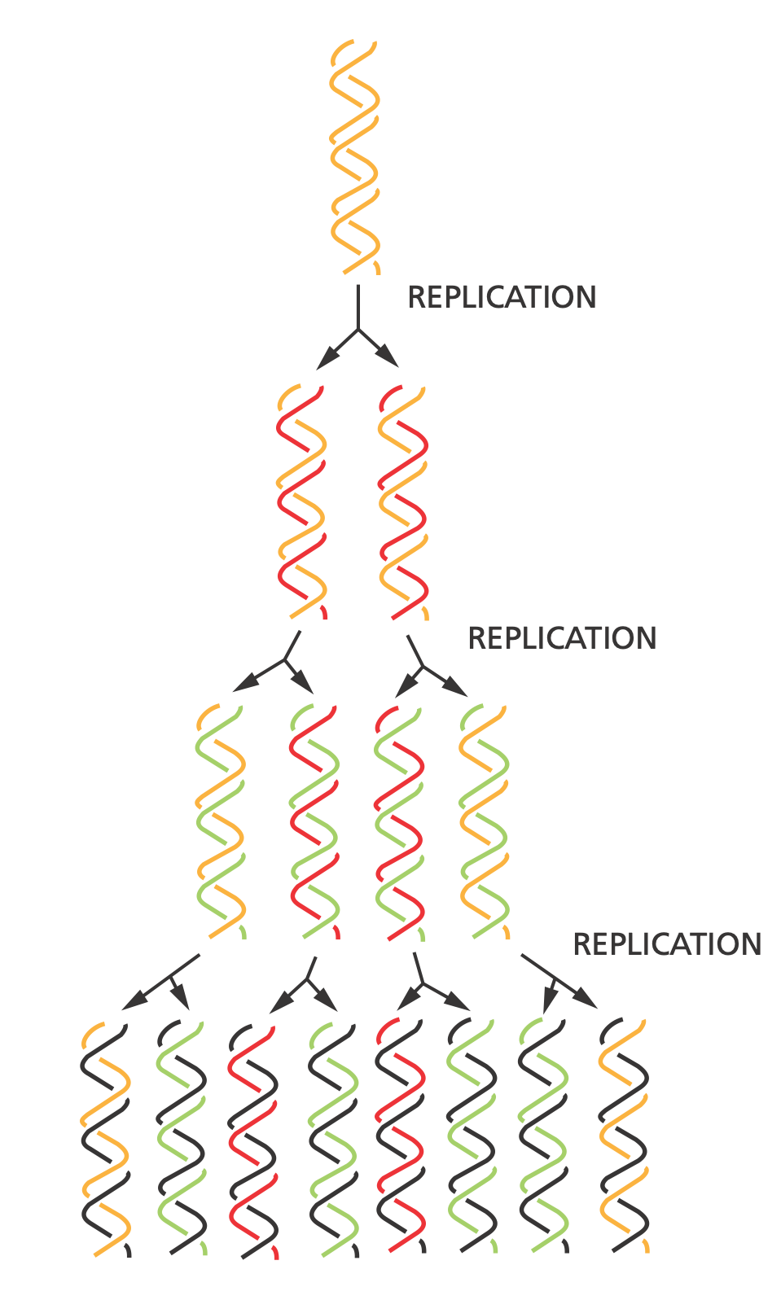
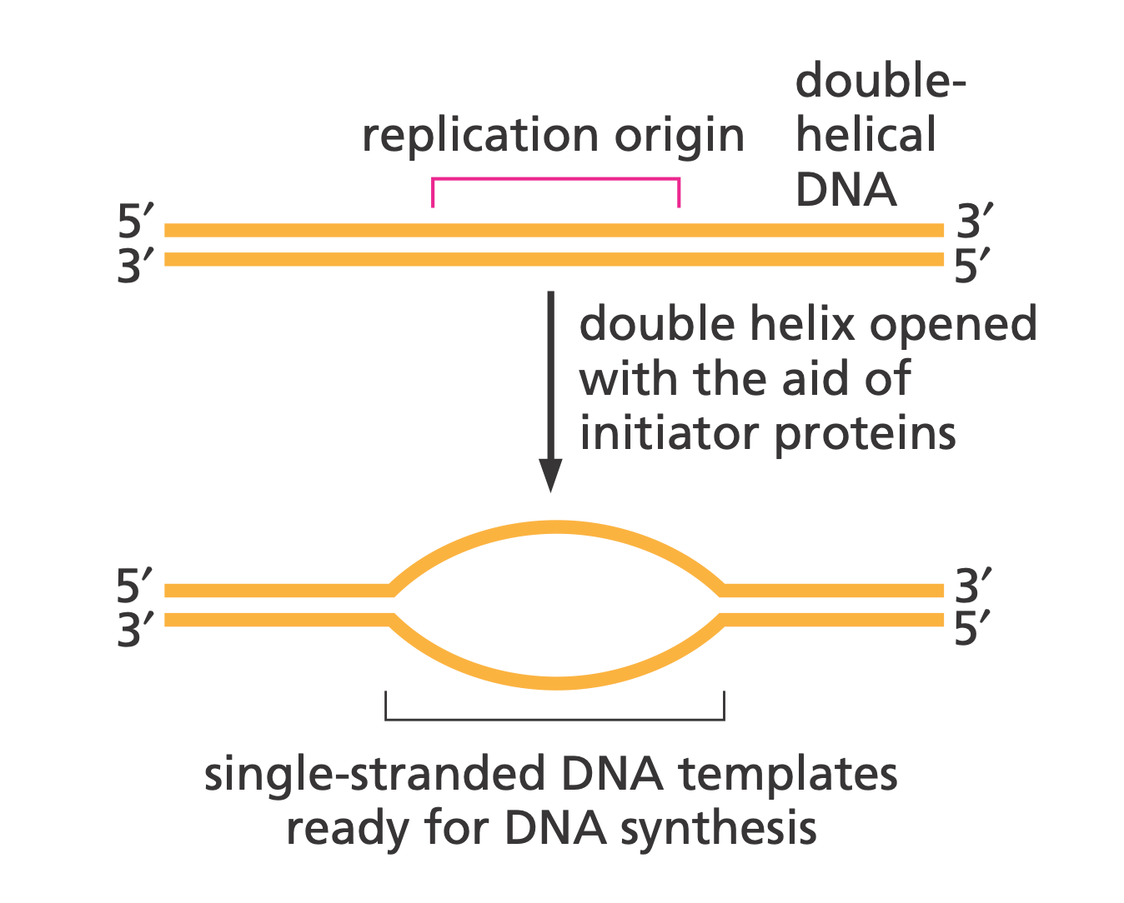
DNA Replication

Slide 19
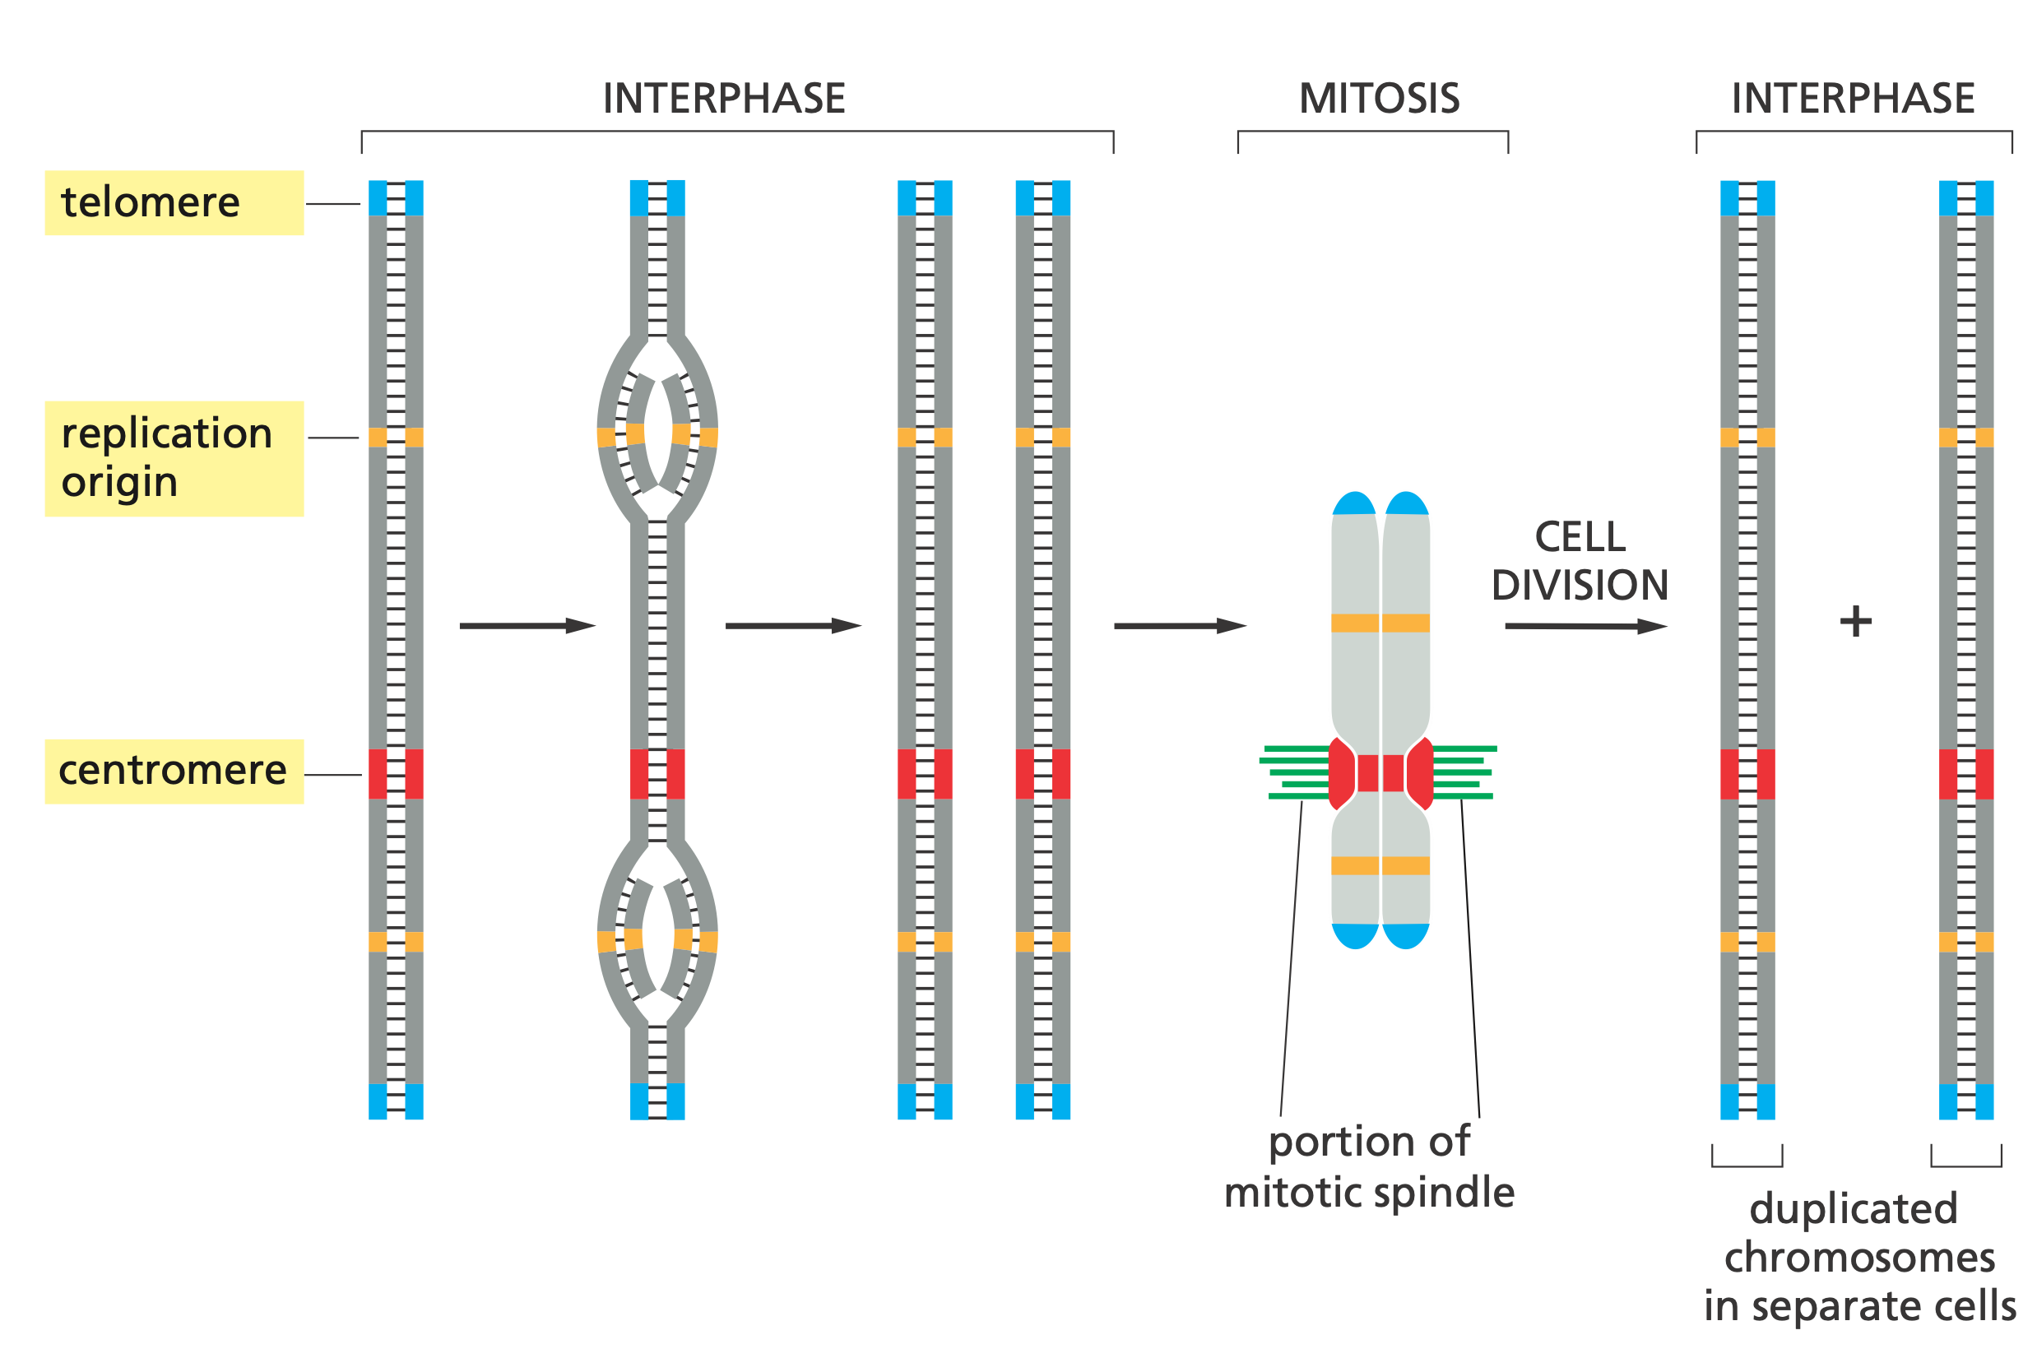
Cell Division Elements
Notes:
Each chromosome has multiple origins of replication, one centromere, and two telomeres.

Slide 20
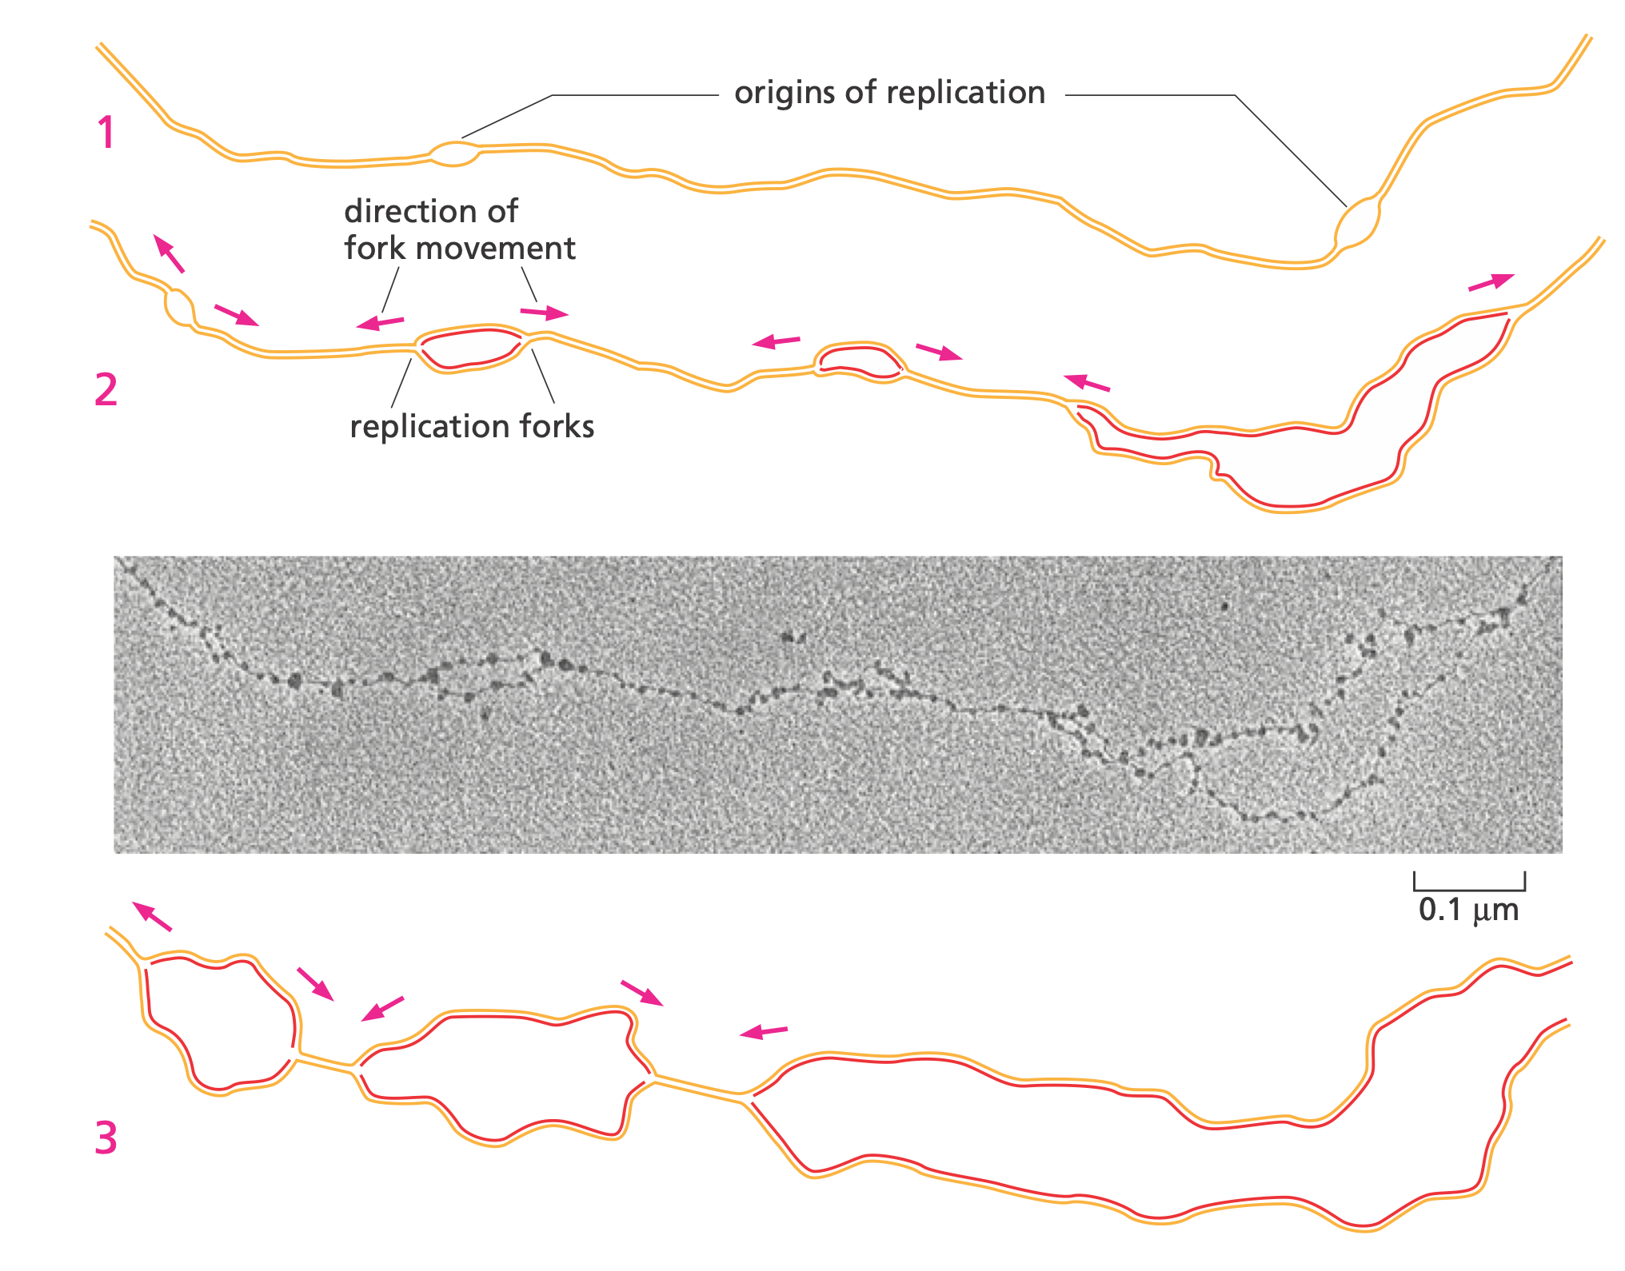
Origin of Replication

Slide 21
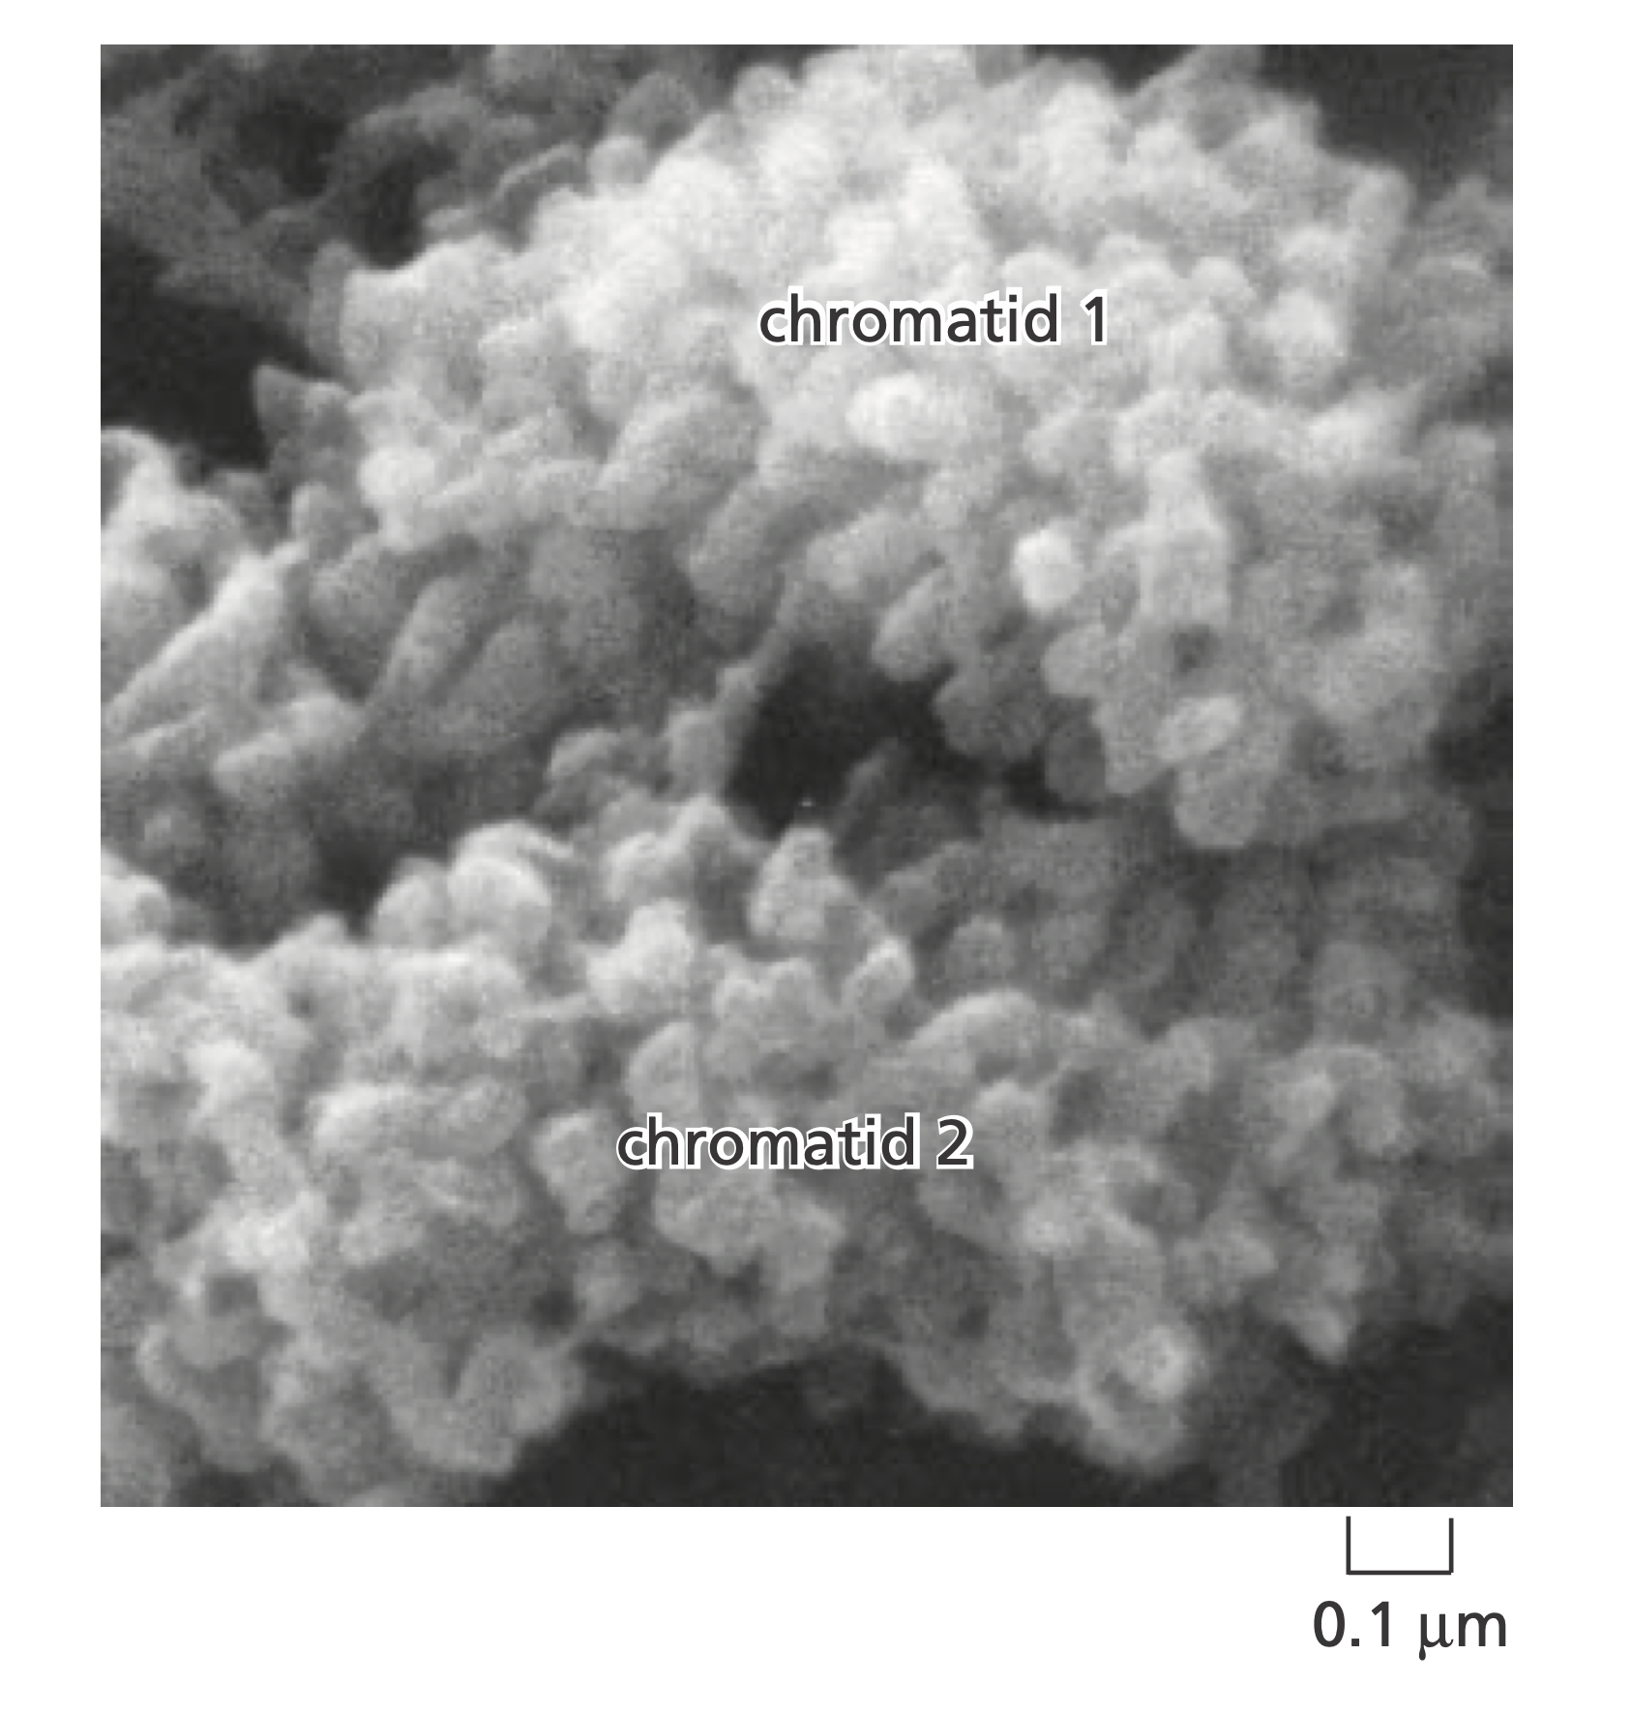
Mitotic Chromosomes

Slide 22
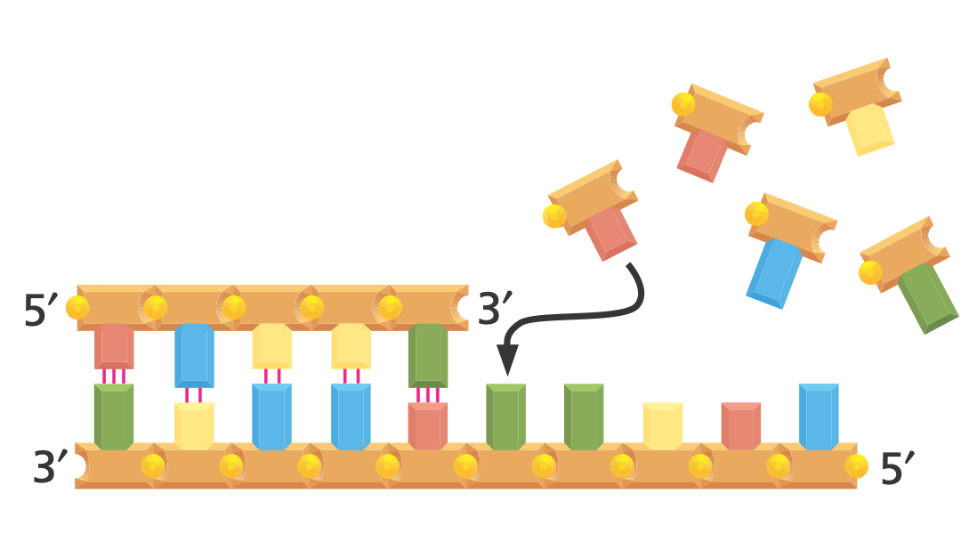
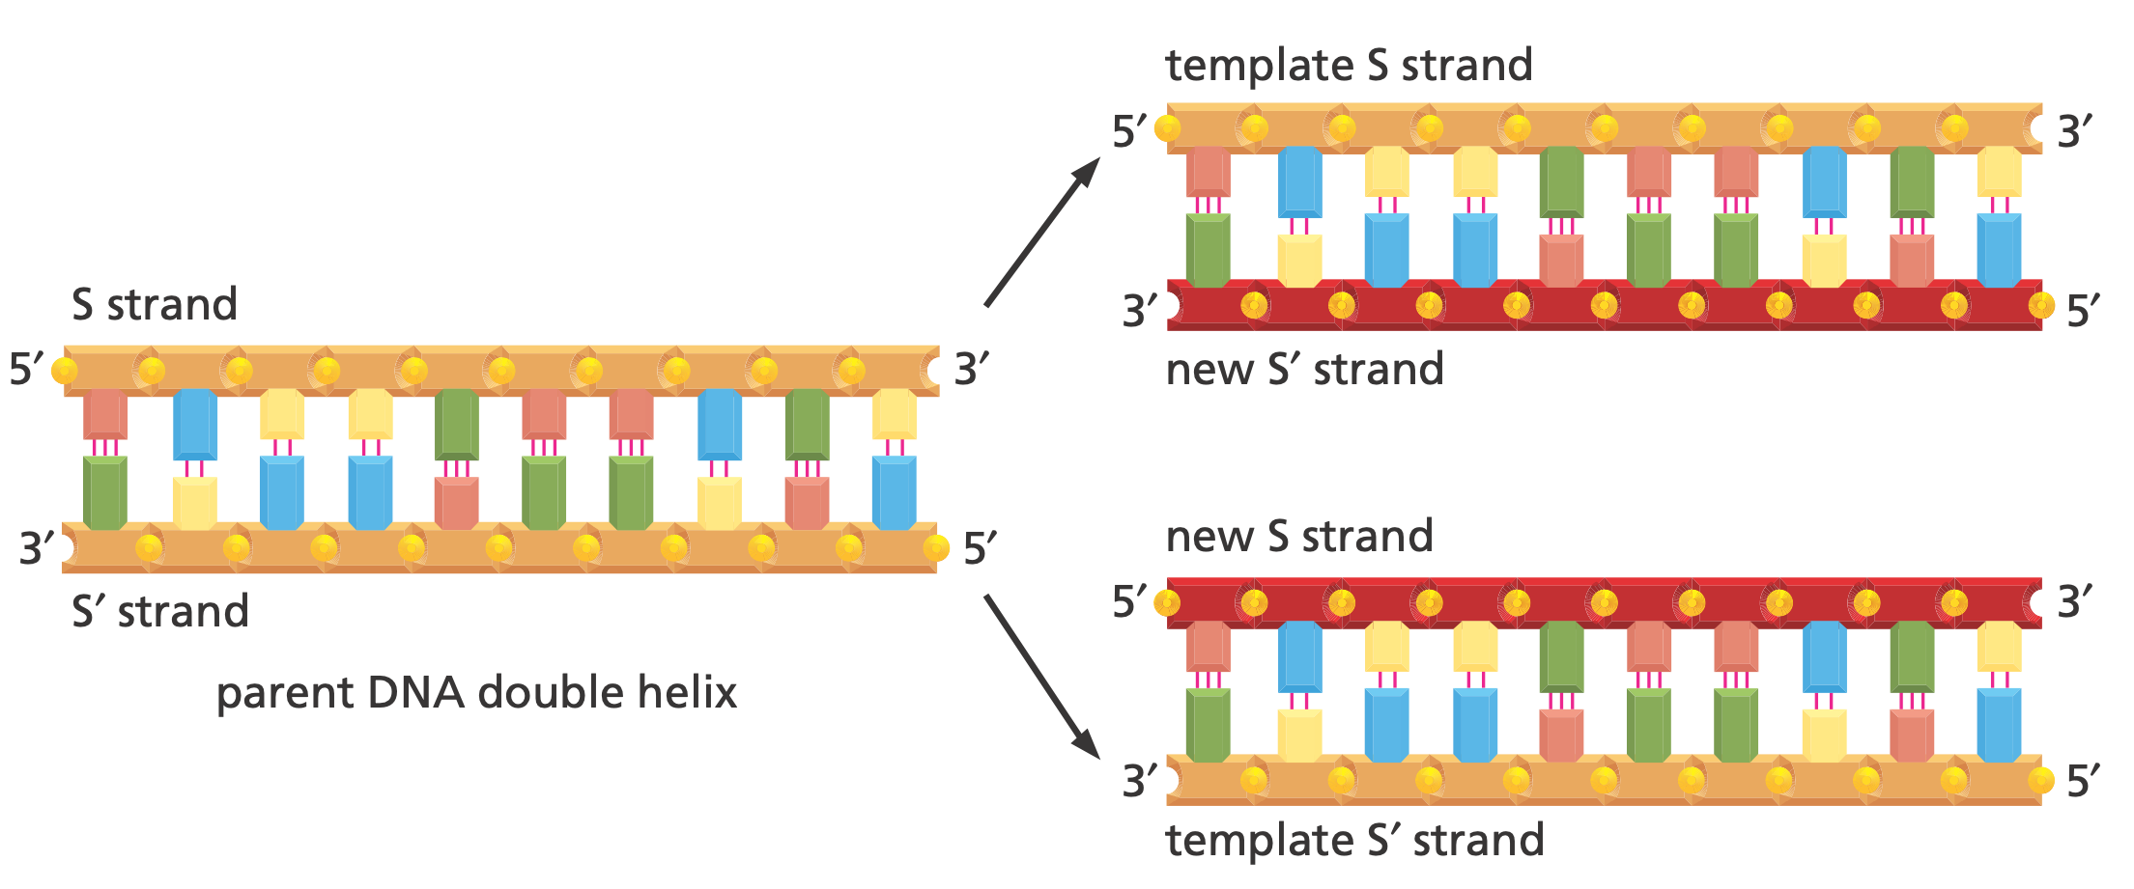
DNA as a Template

Slide 23
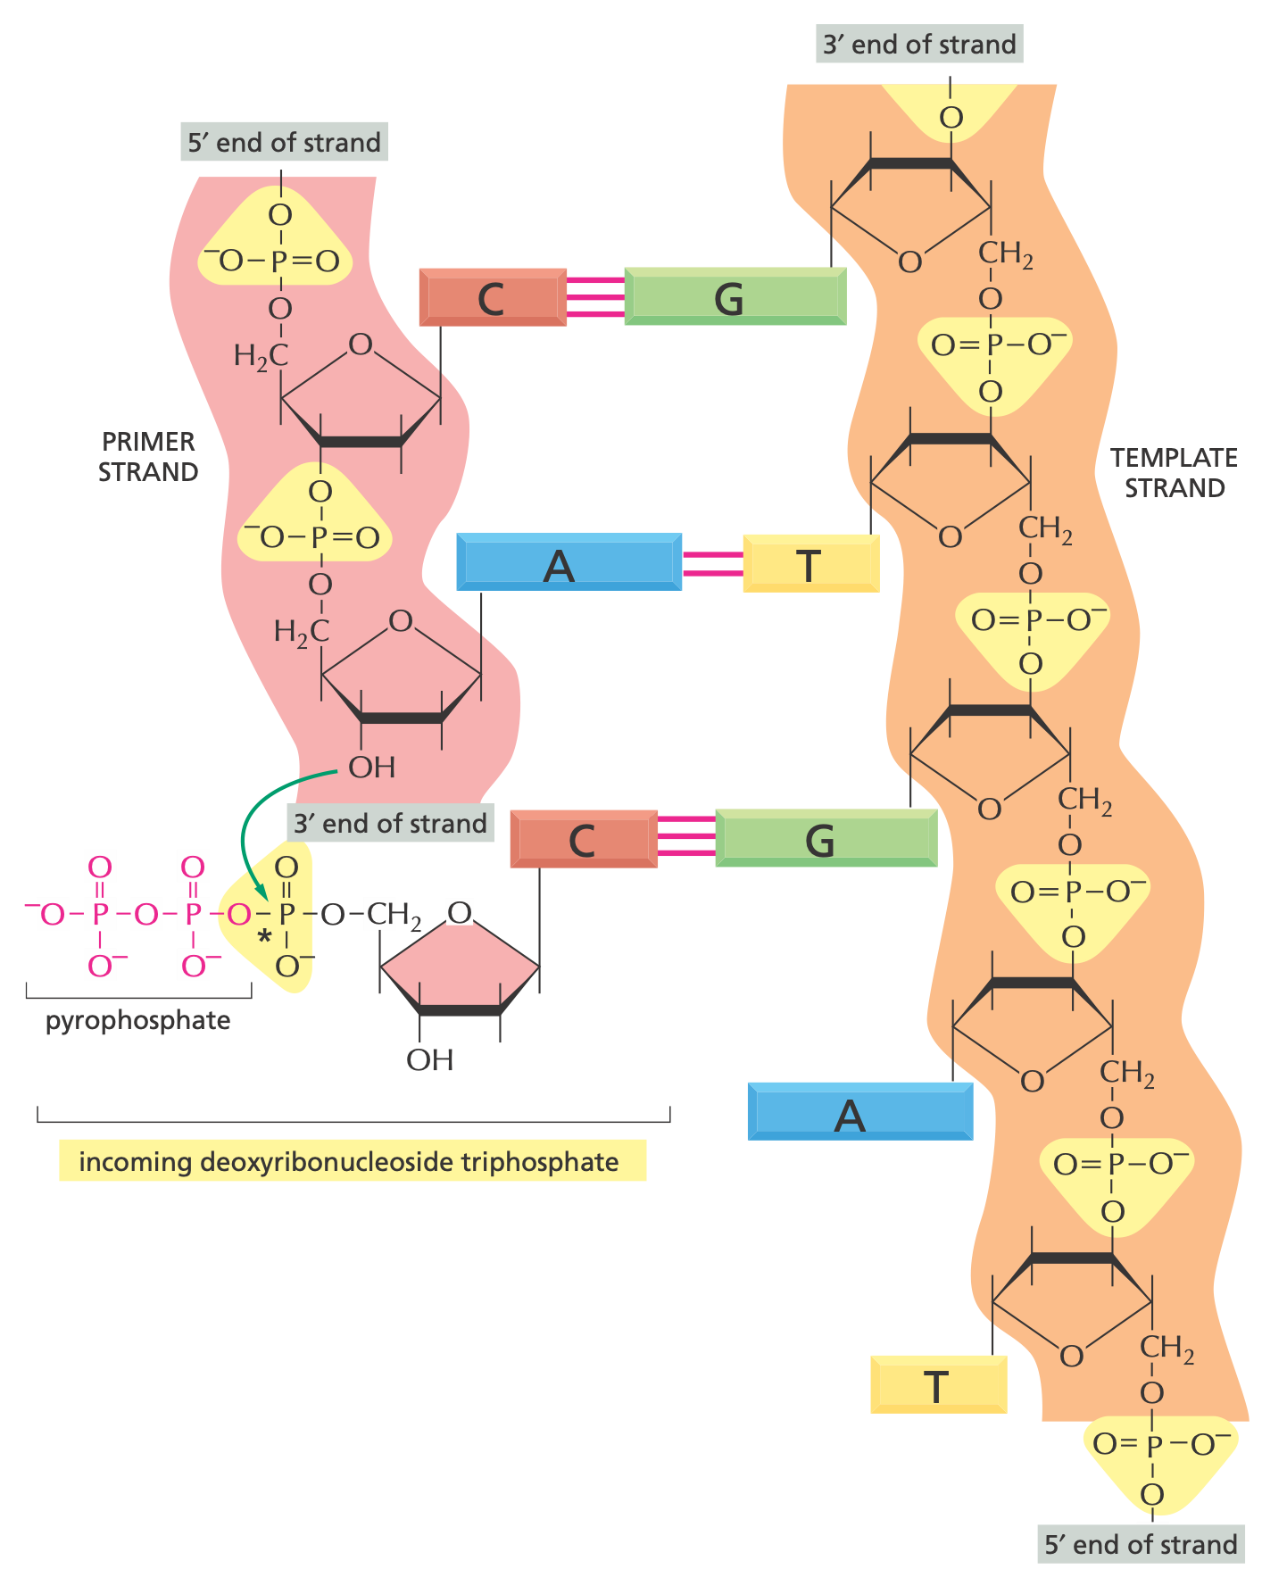
DNA Synthesis
Notes:
5’ to 3’ direction

Slide 24
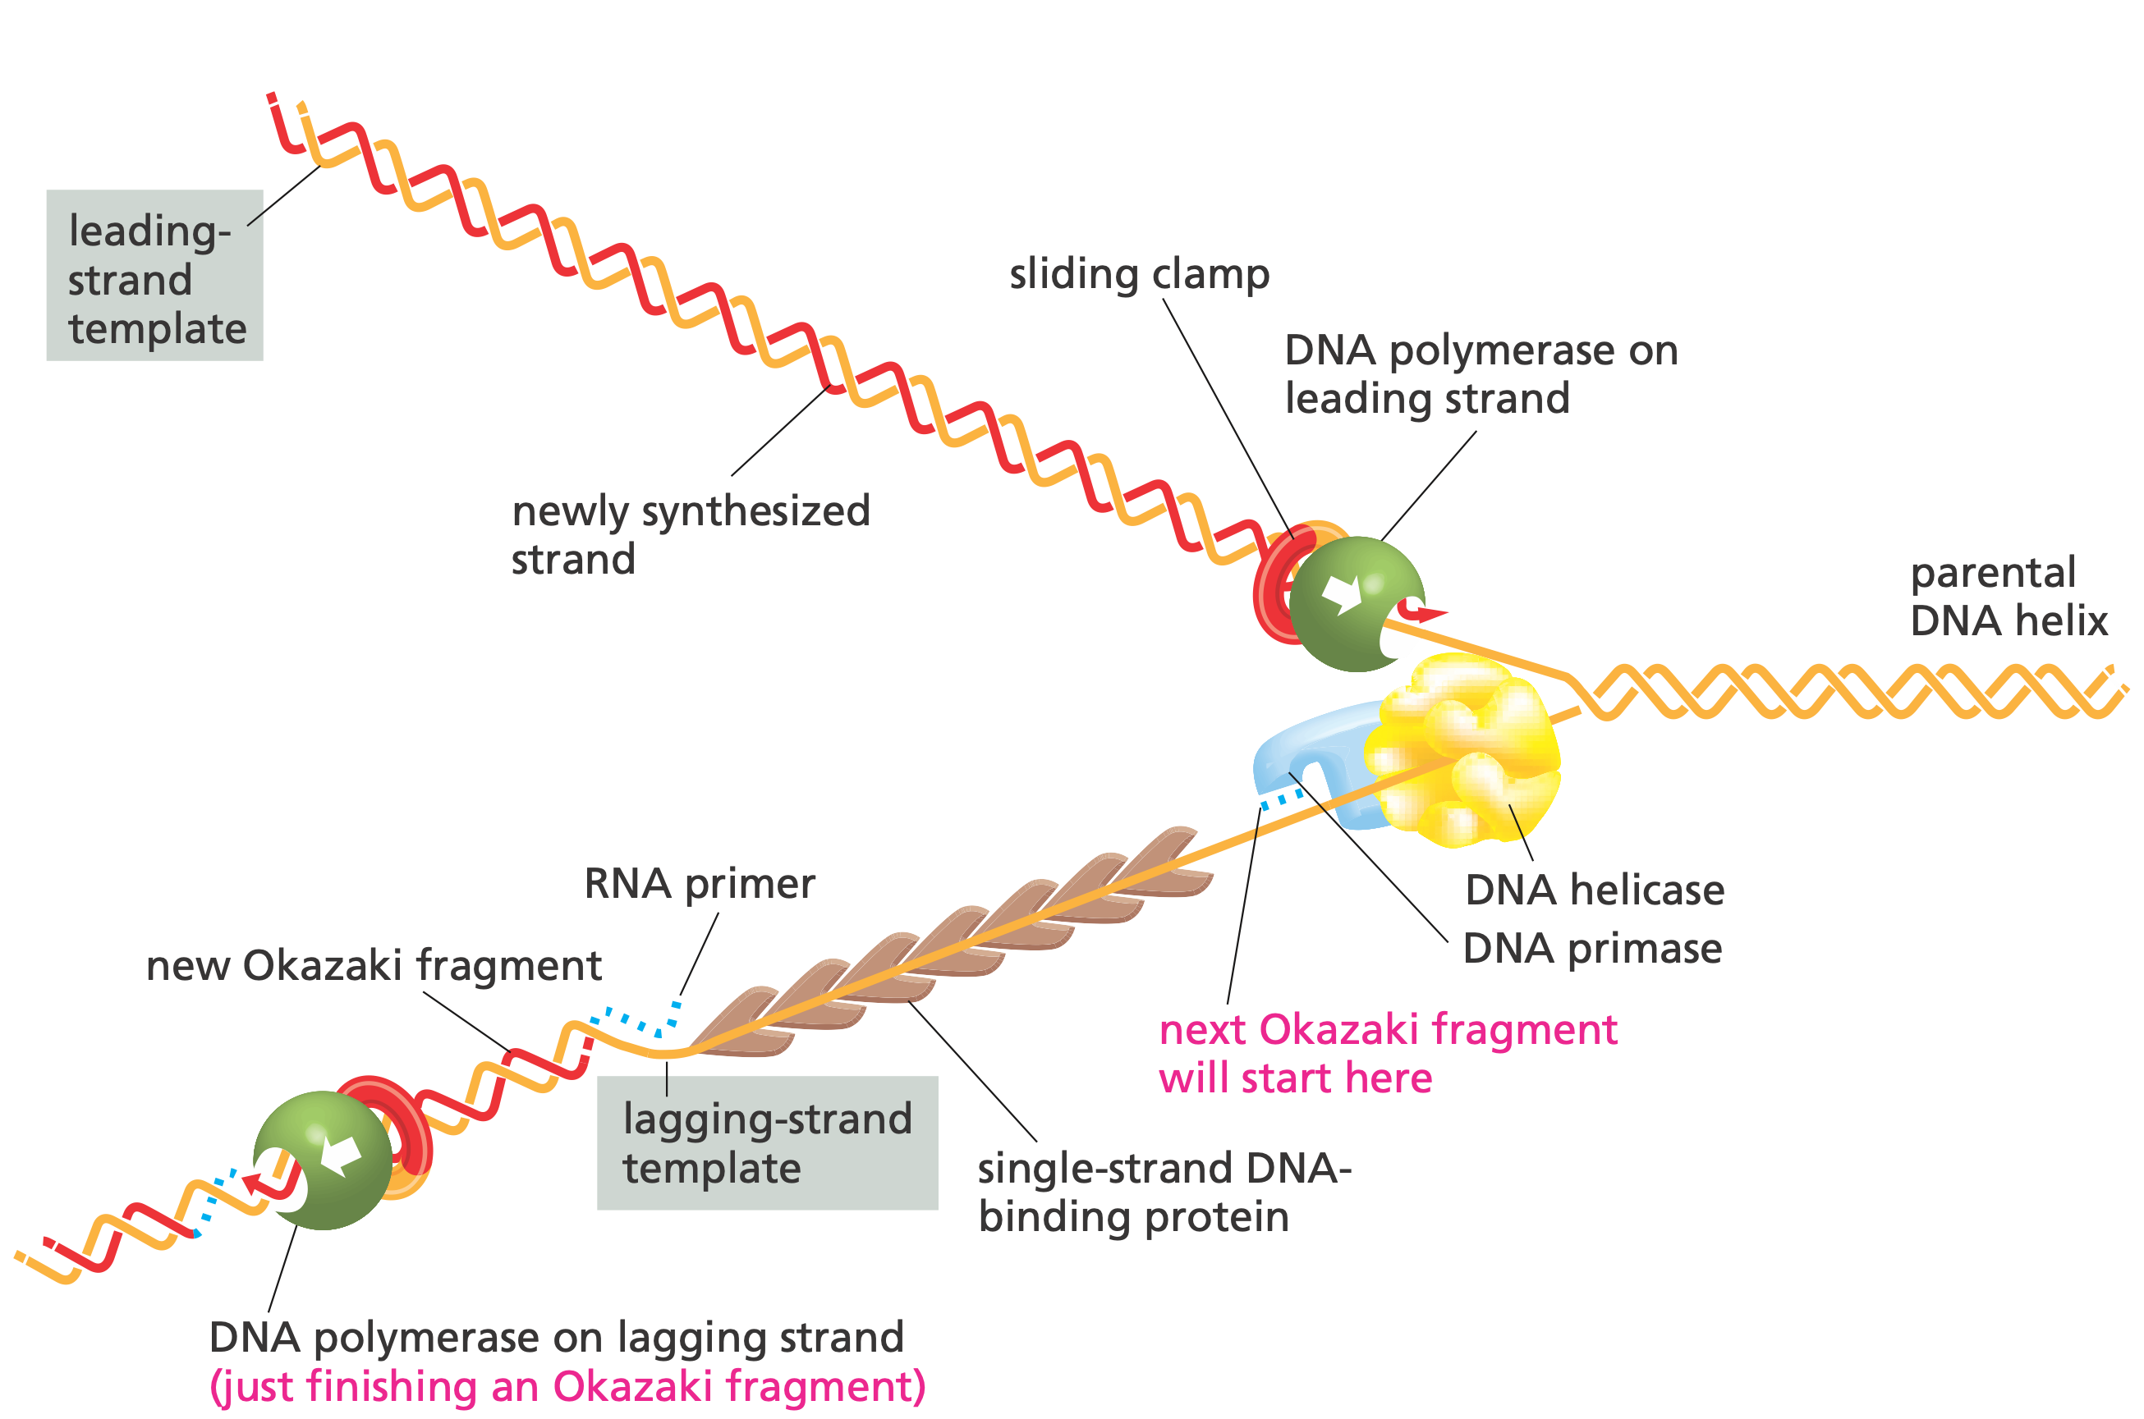
DNA Synthesis Machine

Slide 25
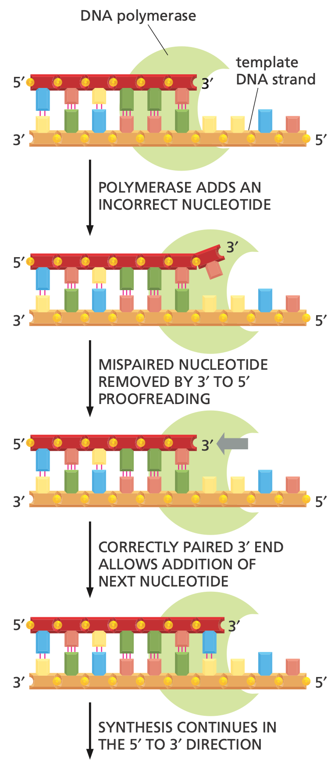
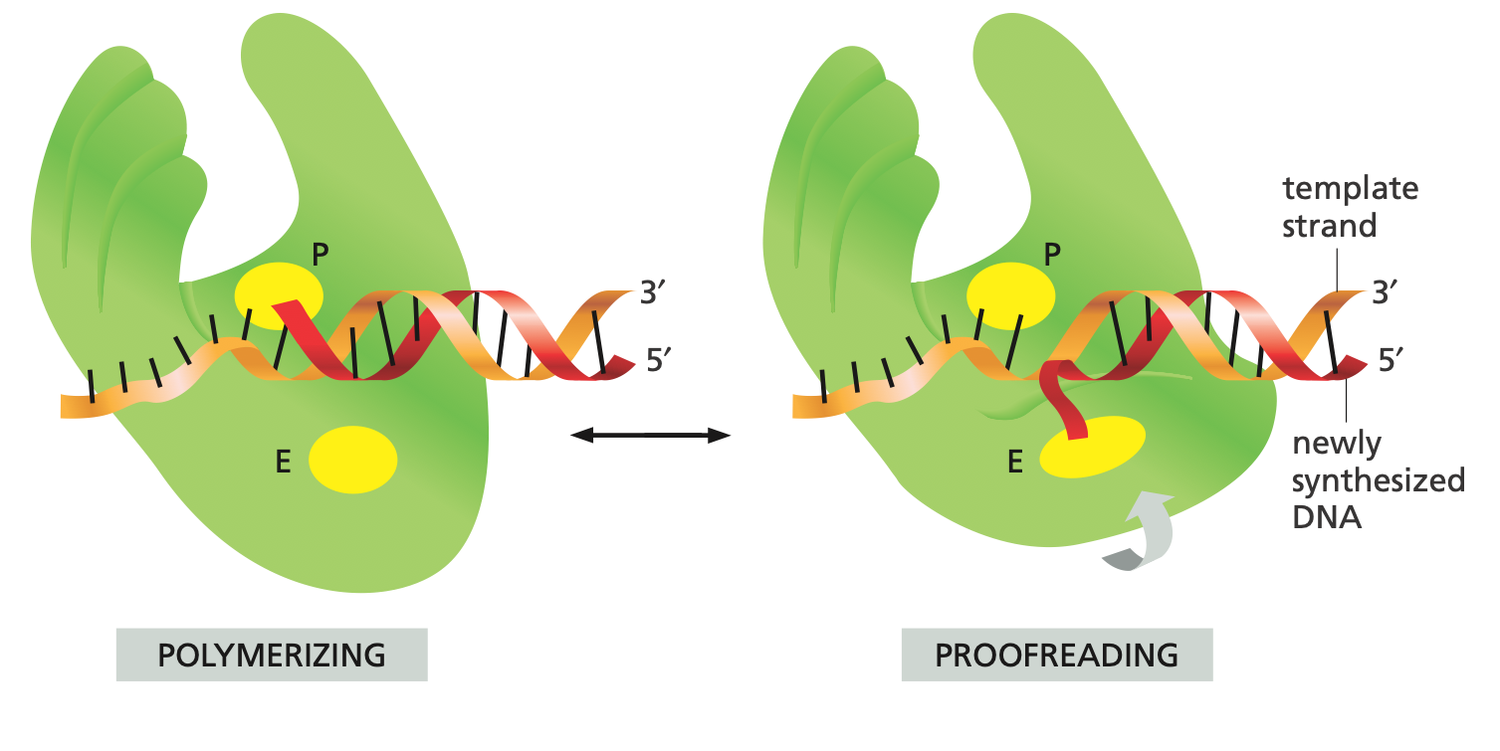
Proofreading

Slide 26
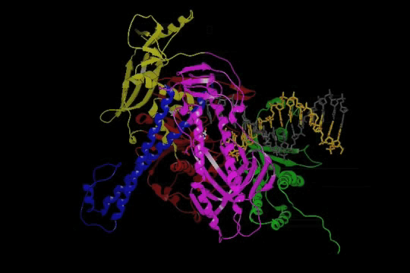
DNA Polymerase

Slide 27
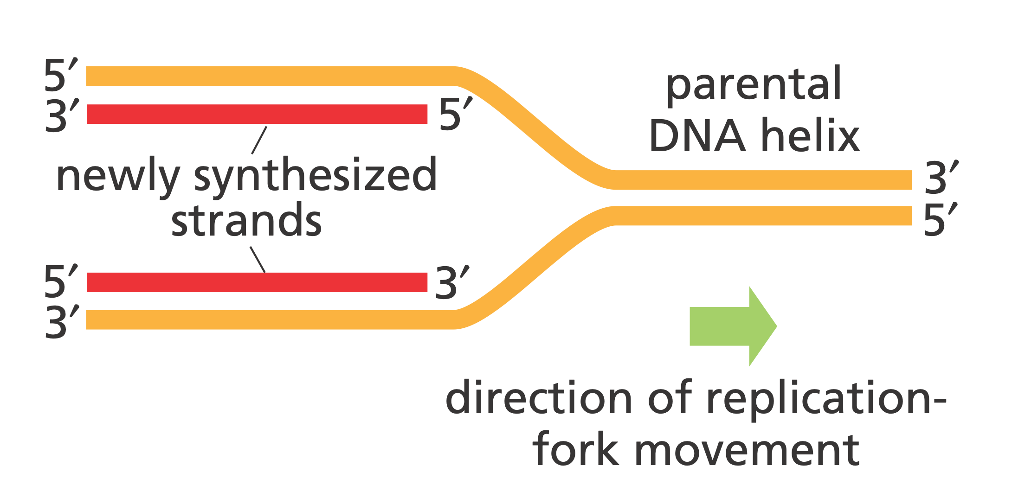
How it can Happen?

Slide 28
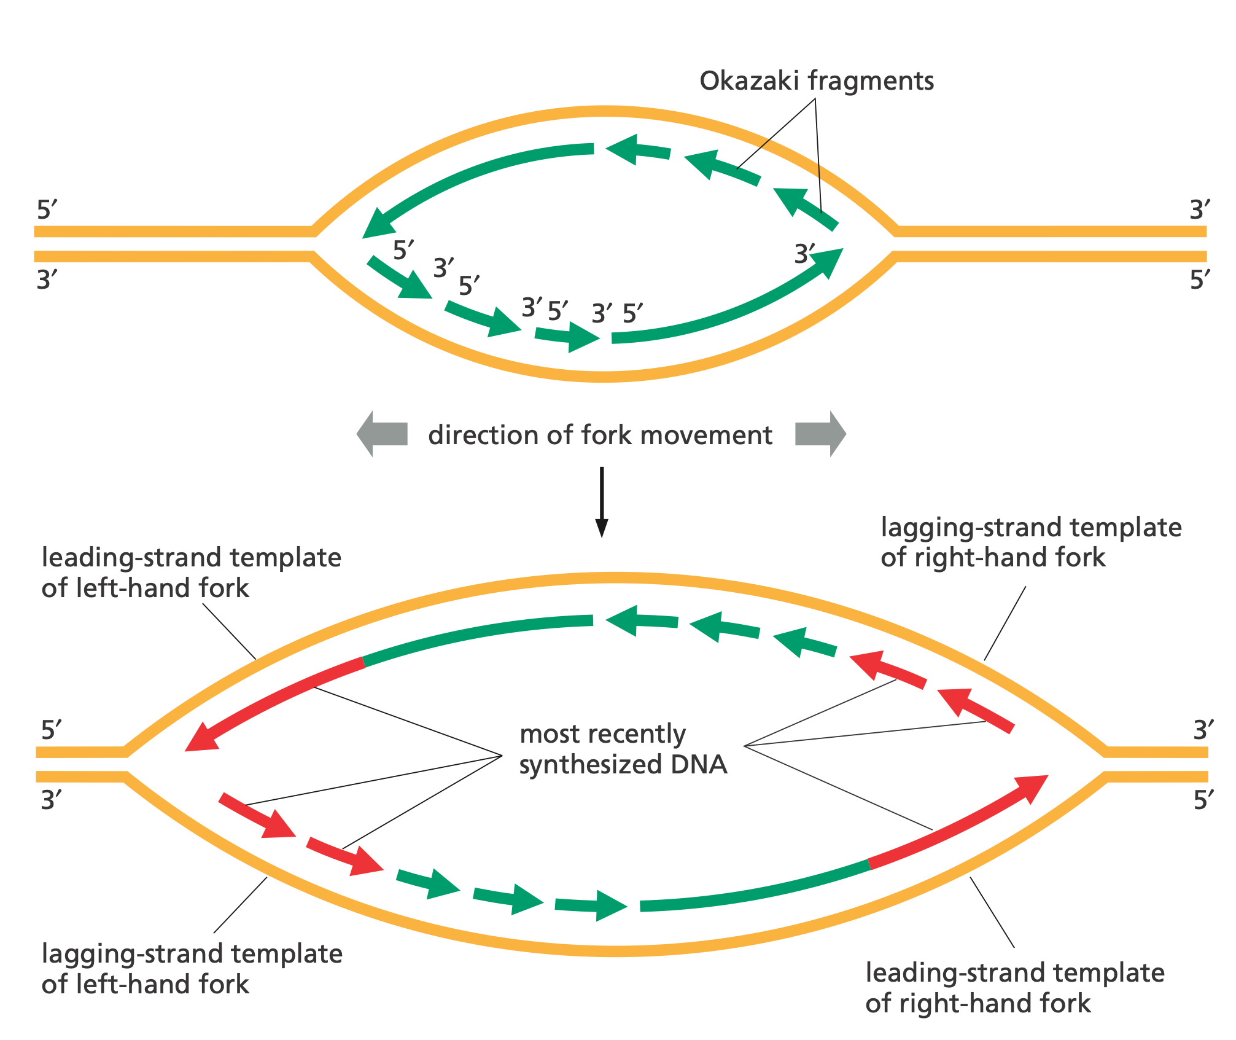
DNA Replication Forks

Slide 29
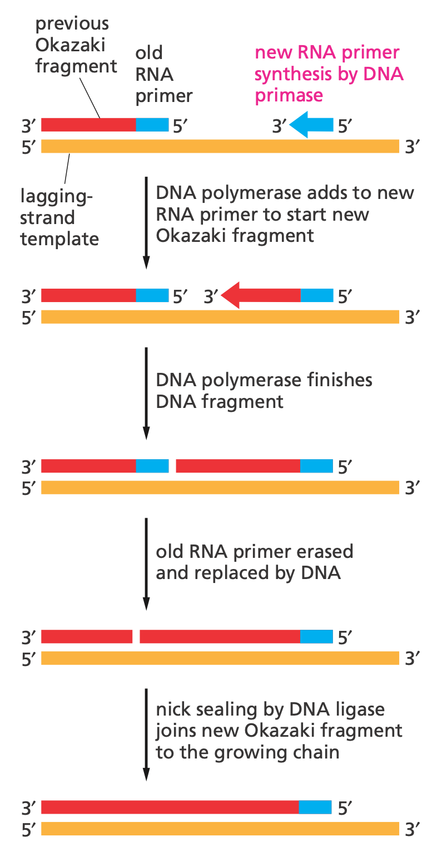
Lagging Strand Synthesis

Slide 30
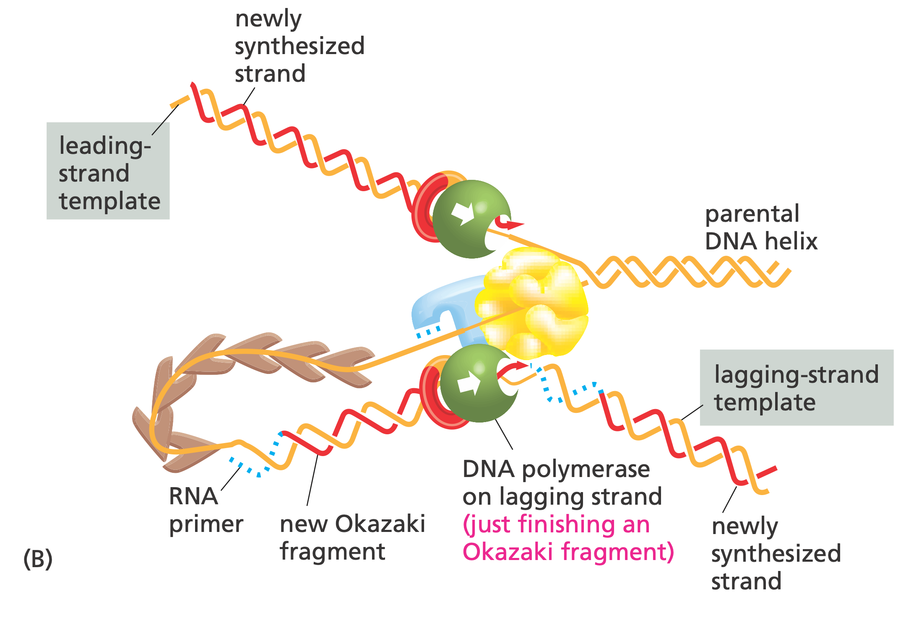
DNA Replication Machine

Slide 31
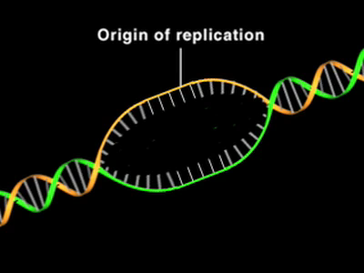
DNA Replication Machine

Slide 32
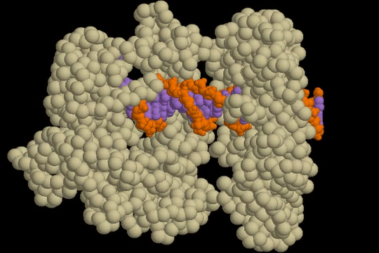
DNA Replication Machine

Slide 33
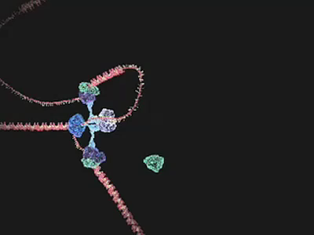
DNA Replication Machine

Slide 34
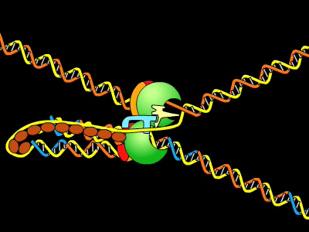
DNA Replication Machine

